Slide 1


Modeling the biodiversity crisis : the roles of space and strategic behavior in bioeconomic modeling
PhD Defense – Simon Jean
Supervision : Dr. Lauriane Mouysset (CNRS, CIRED) & Dr. Christopher Costello (UC Santa Barbara)
Reviewers : Dr. Nicolas Quérou (CNRS, CEE-M) & Dr. Agnès Tomini (CNRS, AMSE)
Examiners : Dr. Mireille Chiroleu-Assouline (PSE), Dr. Charles Figuières (AMSE), Dr. Martin Quaas (University of Leipzig, iDiv), Dr. Jim Sanchirico (UC Davis)

Slide 2
Biodiversity is facing an anthropogenic crisis
Ecosystems
« The health of ecosystems on which we and other species depend, is deteriorating more rapidly than ever. We are eroding the foundations of our economies, livelihood […] and quality of life worldwide »
Sir Robert Watson, chair of IPBES
Species
Functions
Genetic
Notes:
Biodiversity i.e. the variety of life forms at diverse taxonomic levels (gene, species and communities), is threatened at all levels.
Read the quote

Slide 3
Challenges associated with anthropogenic drivers
Land/sea use change
Over (under) exploitation
Spatial externalities
Rival uses and opportunity costs of land
Spatial spillovers of ecological and economic processes
Large scales and multiple actors
Financial opportunity cost of conservation
Ill defined property rights over ressource
Large scales and multiple actors
Strategic interactions
Coordination issues
Notes:
Land and see use change is underpinned by various issues :
Rival uses over land, thus triggering opportunity costs of providing habitat
Habitat needs to be connected, and ecological processes have spatial spillovers : the loss of habitat is key, but also the extent to which it is connected.
And large scales and multiple actors, with, as stated before, different objectives, but that need to be coordinated
For over exploitation (or under control in the case of economically costly species) :
Financial opportunity cost of conservation (should I fish one more fish?)
Ill defined property rights over ressources, which can stem from lack of governance, or spatial interdependencies
And large and multiple scales and actors for various species : can be small scale but numerous actors, etc
These underlying phenomena create:
Spatial externalities, which can be more or less shaped, or integrated in economic decision making
strategic interactions, i.e interactions where people respond to other’s actions
And coordination issues, to

Slide 4
Bioeconomic modeling : a framework for analysis
Economic modeling How do rational agents make their choices to satisfy diverse goals?
Bioeconomic modeling How do rational agents interact among each other and with populations, species, communities and ecosystems to satisfy diverse goals
Ecological modeling How do populations, species, communities and ecoystems function?
Notes:
It mixes economic modeling
With ecological modeling

Slide 5

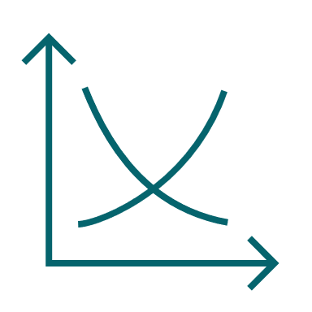

Research questions
What are the effects of endogenous spatial processes on the drivers of biodiversity loss?
How can bioeconomic models be refined to take into account these effects?
What are the effects of strategic interactions on the drivers of biodiversity loss?

Slide 6
This dissertation
 |  | Loss and fragmentation of habitat | Over/under exploitation | Endogenous spatial processes | Strategic interactions
Chapter 1 | Literature review
Chapter 2 | Wildfire risk management
Chapter 3 | Nuisance species
Chapter 4 | Endangered fish
Notes:
In my dissertation, I address the two highlighted drivers of biodiversity loss, along with the specific issues of the management of endogenous spatial processes and strategic interactions.
First, I’ll go over a literature review of bioeconomic on land
Then I’ll focus on the management of wildfire risk, while maintaining habitat
Third, we’ll see how the management of nuisance, such as deer, imply tackling habitat fragmentation and under control of the species, thus digging into the interaction of spatial processes and strategic interactions
Finally, we’ll look at how an endangered fish, totoaba, is threatened by market strategic interactions, which can be redesigned to deliver conservation benefits.

Slide 7
Chapter 1
A review of bioeconomic modeling on land Systematic methodological and narrative analysis
How to manage spatial wildfire risks while safeguarding biodiversity habitat? A graph theoretical approach to multi-objective spatial optimization
Controling and fencing with invasive species Endogenizing species movement at the landscape scale
Can farming save Totoaba macdonaldi, the cocaine of the sea? Market strategic interactions for conservation

Slide 8

A review of bioeconomic modeling on land
Question : what are the methods and questions of bioeconomic modeling on land?
Method : Systematic review (319 articles)
Results :
harvesting and control v. conservation paradigms
Harvesting and control
A species population is monetized and managed by different agents to
Maximize flow of net benefits (consumption and beyond)
Minimze losses from invasions of pests in forest
Conservation
A planner tries to protect a collection of species through space and time under a budget constraint
How to fill Noah’s Ark?
How to incentivize conservation in productive landscapes?
Identified gaps:
Spatial processes : chapters 2 & 3
Strategic behavior : chapters 3 & 4
Uncertainty
Inclusion of statistical methods
Bioeconomic models for terrestrial social ecological system management: a review, with L. Mouysset, International Review of Environmental and Resource Economics, 16 (1), 2022
Appendix
Notes:
Because bioeconomic is quite recent, especially on land, we ask what are its methods and questions?
Existing articles focus on specific dimensions of bioeconomic modeling, i.e. either the theme, or the methods, and not the narratives (what is the story developed in the model)
We focus on the methodological features of each article, as well as the narrative deployed and find two main groups

Slide 9
Chapter 2
A review of bioeconomic modeling on land Systematic methodological and narrative analysis
How to manage spatial wildfire risks while safeguarding biodiversity habitat? A graph theoretical approach to multi-objective spatial optimization
Controling and fencing with invasive species Endogenizing species movement at the landscape scale
Can farming save Totoaba macdonaldi, the cocaine of the sea? Market strategic interactions for conservation
Notes:
Look at how to manage wildfire risk, while safeguarding habitat connectivity

Slide 10






How to manage spatial wildfire risks while safeguarding habitat?
Wildfires likelihood, spread and severity are expected to increase with climate change
Come at immense direct and indirect, current and dynamic costs to humans, as well as biodiversity
Fuel treatments can locally impact the spread and severity of wildfires by breaking fuel connectivity
However, in doing so, they may affect the structural connectivity of habitat, further threatening biodiversity
How should a land planner allocate treatments to diminish the potential damages from wildfires, while safeguarding biodiversity habitat?
Appendix
Notes:
Say in a forest, if trees are grouped, fire can spread.
Fuel treatments, such as prescribed burning, or mechanical clearing, or logging, can locally impact the spread
The closest paper to ours is […] and we differ by Compared to the literature
Wildfires likelihood and severity : Abatzoglou and Williams, 2016; Dupuy et al., 2019; Wasserman and Mueller, 2023
Come at immense direct & indirect costs : Wang et al., 2021 (21B in California); Heft-Neal et al., 2023 (health and smoke exposure) ; Gellman et al. 2024 (recreation)
Fuel treatments : logging, mechanical clearing, prescribed burning
Before research question :
Why intervention of a land planner :
Lots of public lands are concerned
May be difficult to achieve an optimal control in a decentralized fashion because of dynamic spatial externalities of treatments, as risk reduction is a public good; and sizeable transation costs (Other arguments for efficient control such as Costello et al. : while initial risk being high for everyone can lead to optimal level of control, there are heterogeneities in costs and damages from wildfires, which may warrant an inefficient decentralized control)
Need a decision on how to best leverage the properties of spatial spillovers for connectivity
Positioning wrt literature :
The closest paper to what we’re doing here
we extend the existing literature by asking how should a land planner allocate … in an operational and interpretative framework provided by dynamic graph theory

Slide 11
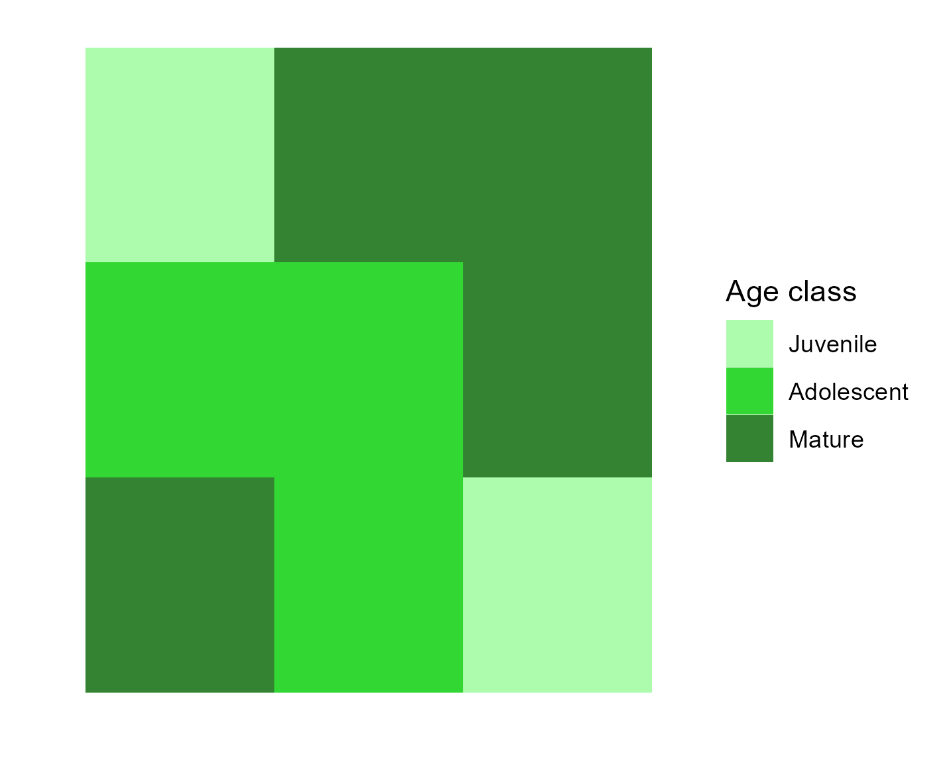
Method : land planning using a dynamic graph theory approach
Question : How should a land planner allocate treatments to diminish the potential damages from wildfires, while safeguarding biodiversity habitat?
Wildfire risk
Mature
Habitat
Yes
Adolescent
No
Juvenile
Treatment
Notes:
We represent a forest using 3 age classes : juvenile, adolescent and mature, with transition at each step
When cells are :
Juvenile, they do not provide habitat nor wildfire risk
In the next period, they are adolescent and provide habitat, but no risk
In the next period, they are mature and provide both habitat and risk

Slide 12
Method : land planning using a dynamic graph theory approach
Question : How should a land planner allocate treatments to diminish the potential damages from wildfires, while safeguarding biodiversity habitat?
Notes:
We use a mathematical framework stemming from graph theory, where each forest pixel can be represented as a node of the habitat and wildfire risk graph
Nodes are connected if :
They are in a 8-cell neighborhood
And either are high risk
Or provide habitat : the high risk graph is included in the habitat graph

Slide 13
Method : land planning using a dynamic graph theory approach
Question : How should a land planner allocate treatments to diminish the potential damages from wildfires, while safeguarding biodiversity habitat?
Minimize Global Connectivity of risky patch:
Treatment removes habitat
And connections
while maintaining Global Connectivity of habitat over time
Using 4x4 landscapes to characterize solutions using wide range of centrality measures
Find rules applicable for large scale (100x100) to avoid dimensionality curse
Notes:
Minimize global connectivity
We use all the possible 4x4 landscapes possible to understand general patterns using repeated and dynamic optimization algorithm, with a wide range of centrality measures from graph theory
To avoid a dimensionality curse, that is to say, avoid having too many state variables

Slide 14
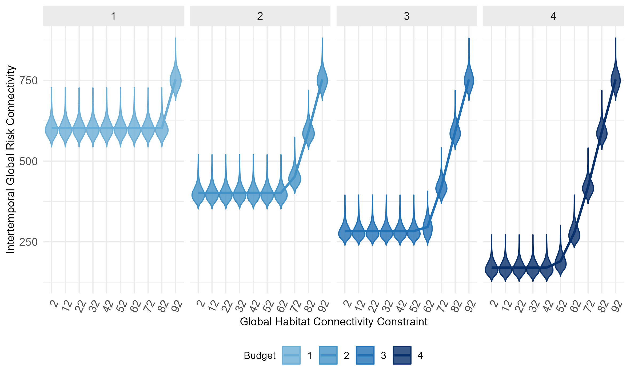
Results: reconciling wildfire risk reduction and habitat connectivity
Notes:
Dynamic and repeated optimization techniques yield similar results
We analyze the 5,4 million landscapes and find that :
Reducing risk is possible while maintaining biodiversity constraints (average is the line)
The larger the budget, the larger the risk reduction for low habitat connectivity targets
As biodiversity targets become larger, the effect of budget is null : no need to spend more.

Slide 15
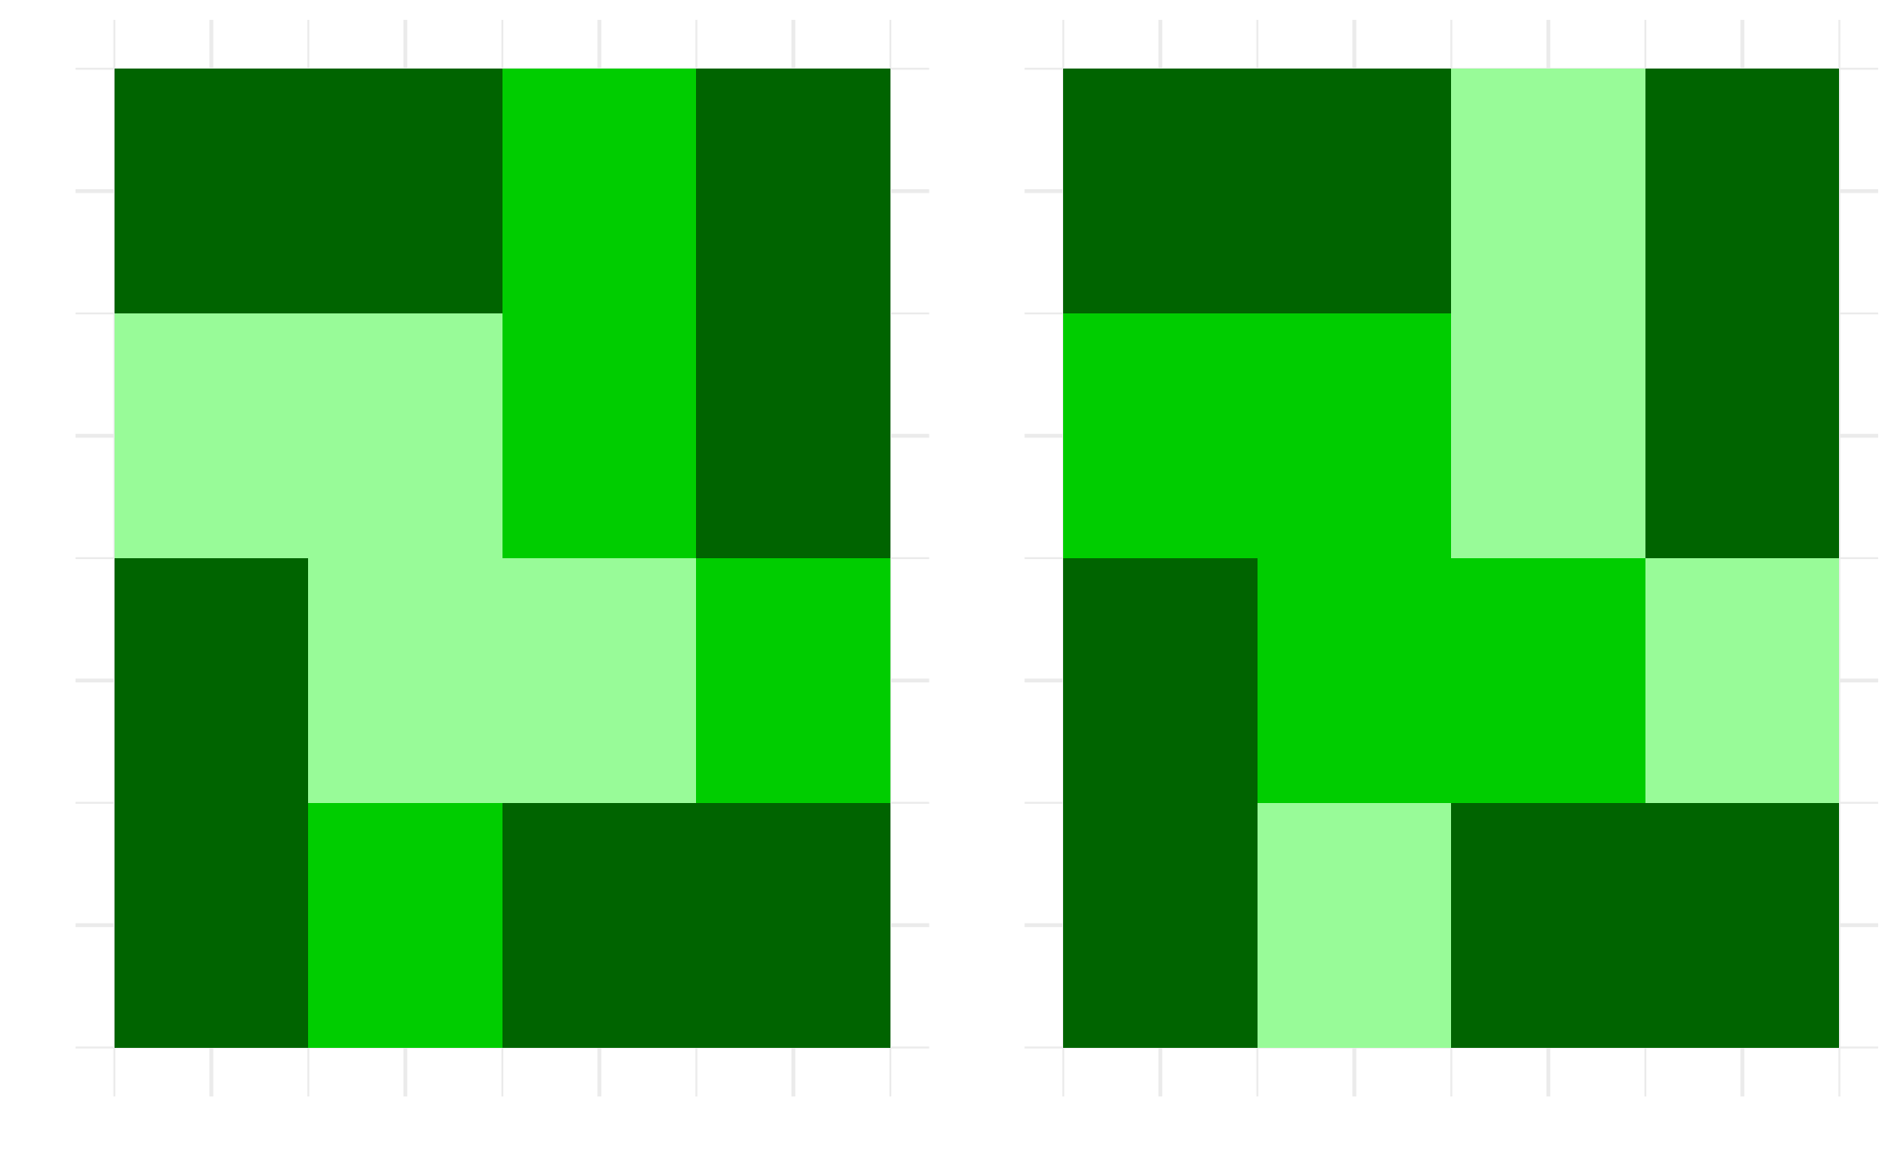
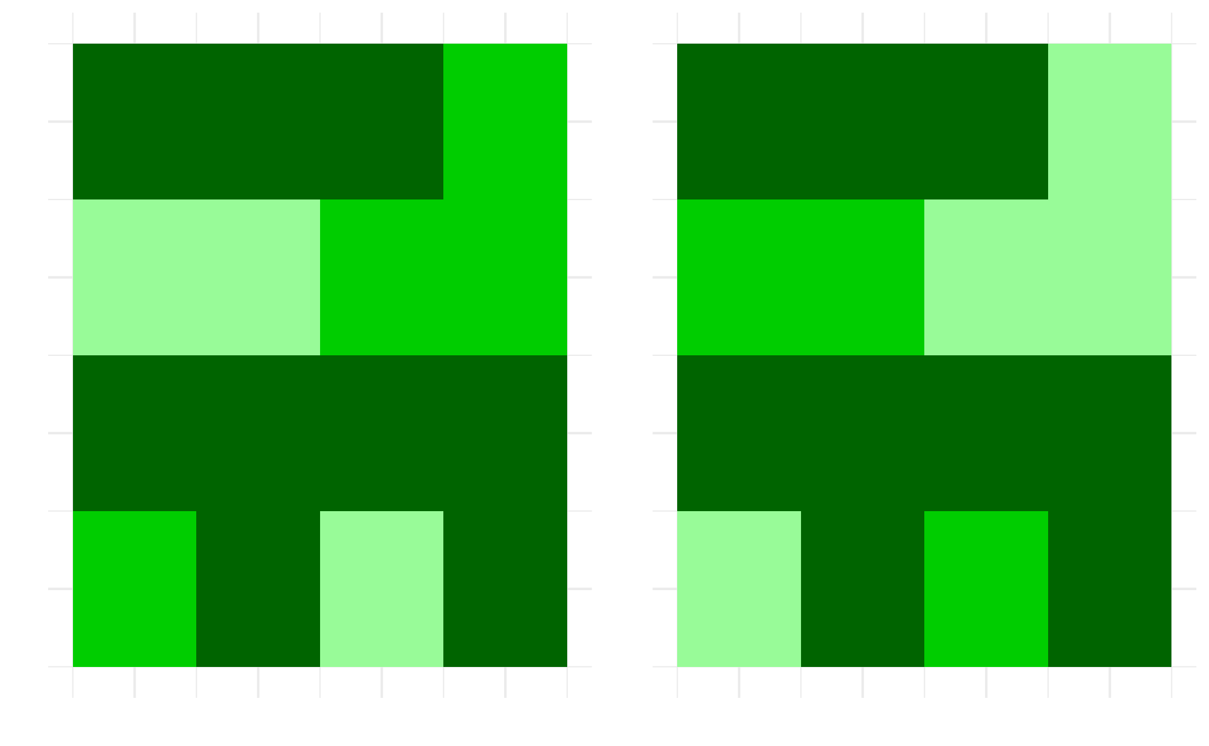
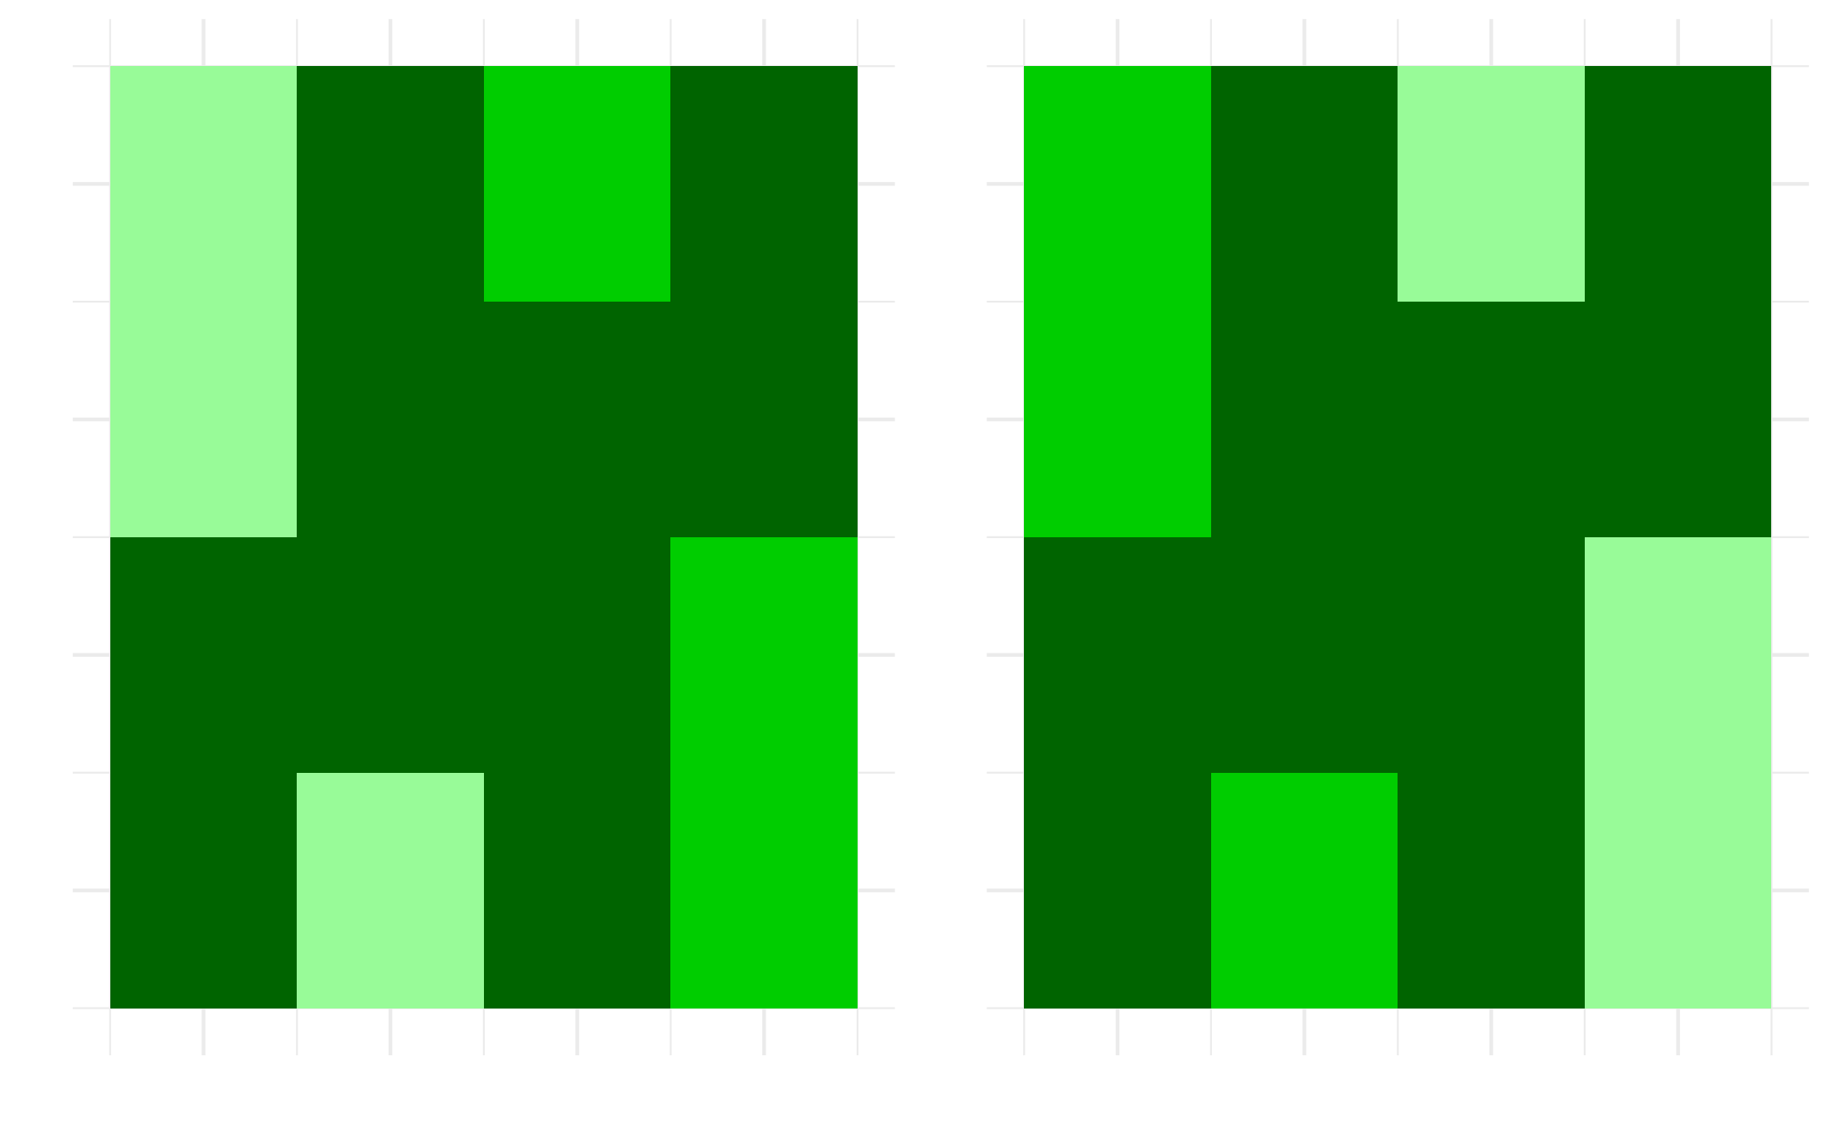
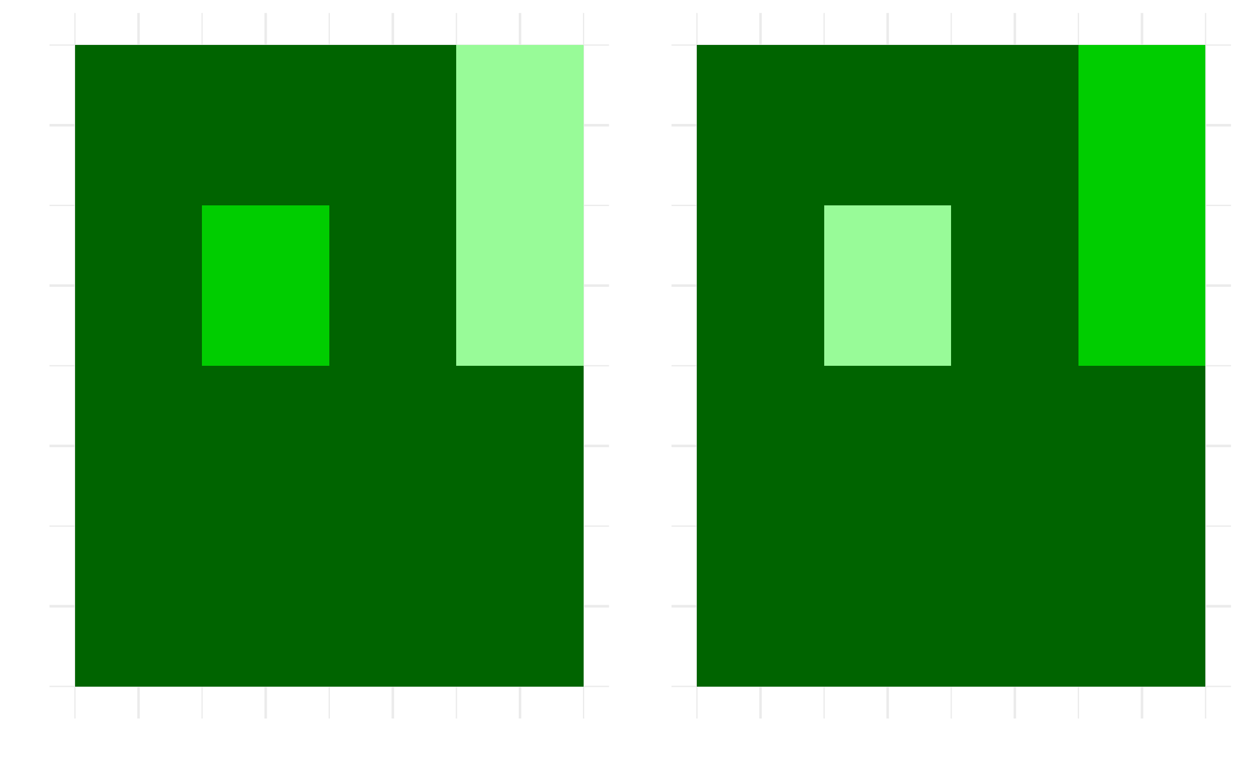
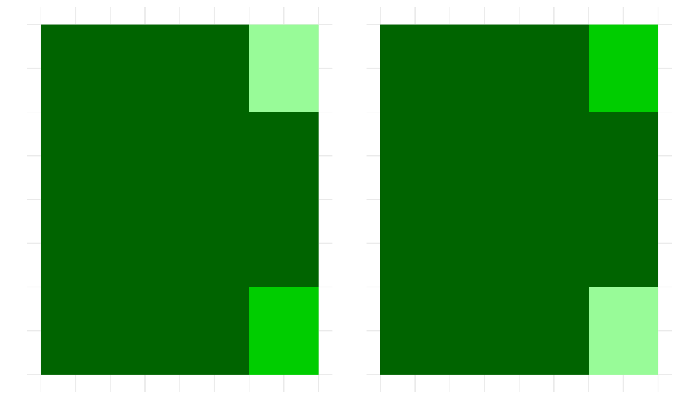
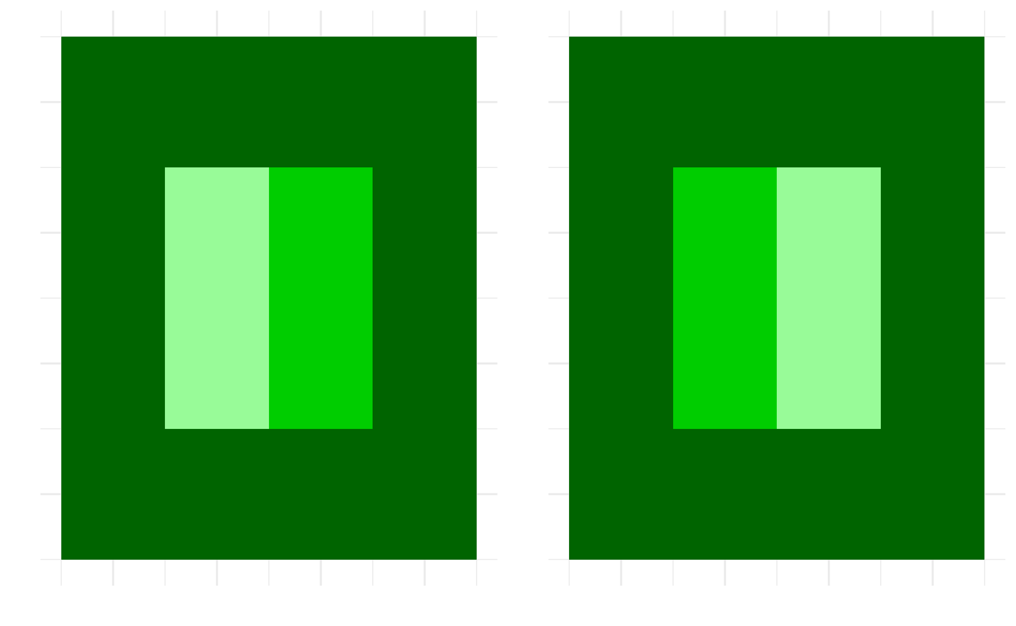
Results: optimal spatial treatment allocation
Budget = 4
With large budget, and low constraint Break mature cells connectivity by targeting central and edge nodes (e.g. lower centrality) Thus increasing disconnected components
With large budget, and increased constraint Budget is not saturated, less disconnected components, more low centrality nodes are targeted
With large budget, and large constraint Budget is not saturated, only low centrality nodes are targeted, identical as with low budget
With low budget, and low constraint Break mature cells connectivity by targeting most central nodes
Budget = 2
Juvenile
Adolescent
Mature
Global Habitat Connectivity Constraint
Notes:
Our simulations converge to steady state cycles i.e. landscape cycles that repeat themselves indefinitely after convergence.
These cycles represent 0.001% of the initial landscapes to consider so we study them
When refering to central nodes, I mean various of graph theory centrality: betweenness, eigencentrality etc

Slide 16

Question : How should a land planner allocate treatments to diminish the potential damages from wildfires, while safeguarding biodiversity habitat?
Methods : Dynamic minimization of global risk connectivity under constraint with heuristics
Conclusions :
Endogenous spatial processes need to be carefully managed to achieve risk reductions, as the surrounding context matters.
With rival objectives, endogenous spatial processes can be managed to reconcile the two, although they come at a trade-off for extreme values
The scalability of results from small to large scale are difficult but intuitions & interpretation can be passed on for improved spatial allocation of treatment as
The wildfire-habitat connectivity dilemma : a graph-theoretical approach to landscape management, with L. Mouysset
Appendix
Notes:
Final point : Scalability + interpretation is our main contribution : graph theory is a powerful tool to think about that.

Slide 17
Chapter 3
A review of bioeconomic modeling on land Systematic methodological and narrative analysis
How to manage spatial wildfire risks while safeguarding biodiversity habitat? A graph theoretical approach to multi-objective spatial optimization
Controling and fencing with invasive species Endogenizing species movement at the landscape scale
Can farming save Totoaba macdonaldi, the cocaine of the sea? Market strategic interactions for conservation

Slide 18
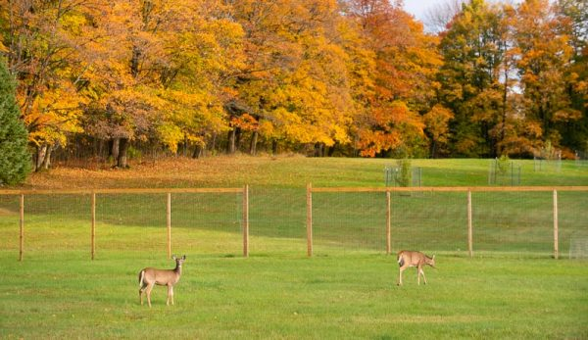
Dispersal is not an exogenous process
For some wildlife species, large population densities cause damages and control costs
These species disperse through space
Landowners have more than 1 tool to diminish damages :
Control of population
Control of dispersal : fences
What is the best way to manage?
What is a non coordinated, realistic way to manage?
Notes:
The main difference with the previous chapter is that the habitat patches and links are pertain to two different decisions, yet interconnected

Slide 19
Managing in situ population and dispersal flows
Question : what is the best way to manage the population in each patch, and dispersal flows?
Methods : dynamic two patch model of a mobile nuisance species which grows and disperses according to control and fencing decisions
Intuition : spatial management arises from the spatial heterogeneity i.e. spatial arbitrage opportunities
Optimal management involves fencing only if
difference in costs,
environmental characteristics
Growth
Cheap fences
Otherwise no arbitrage
Take 2 patches, A and B, such that control is costlier in A
It is worth fencing in B only if what remains in B is larger than what remains in A
Otherwise, increase in costs
Notes:
Method :
two patch model
of population dynamics for a single species
Which cause costs and damages
If it is not worth locally extirpating the species, i.e. if the damages are relatively low at low densities, and costs of extirpation quite large, we have a positive population.
Bottom line story is : if there is value to change the dispersal of resources, then one should do it, such that the marginal costs of control are equal across the landscape.

Slide 20
Managing in situ population and dispersal flows
Question : what is the non-coordinated, more realistic way the species will be managed?
Methods : dynamic two patch model of a mobile nuisance species which grows and disperses according to control and fencing decisions
Intuition : spatial management arises from the spatial heterogeneity i.e. spatial arbitrage opportunities
Optimal management involves fencing only if
difference in costs,
environmental characteristics
Growth
Cheap fences
Otherwise no arbitrage
Take 2 patches, A and B, such that control is costlier in A
It is worth fencing in B only if what remains in B is larger than what remains in A
Otherwise, increase in costs
Notes:
Method :
two patch model
of population dynamics for a single species
Which cause costs and damages
If it is not worth locally extirpating the species, i.e. if the damages are relatively low at low densities, and costs of extirpation quite large, we have a positive population.
Bottom line story is : if there is value to change the dispersal of resources, then one should do it, such that the marginal costs of control are equal across the landscape.

Slide 21
Managing in situ population and dispersal flows
What is a non coordinated, realistic way to manage?
Intuition :
When the bads disperse, there is under control due to spatial externality
Fences allow to avoid dispersion, thus resolving the externality
Take two patch identical patches:
Each landowner has an interest in fencing to avoid inflow from the neighbor
Equilibrium is positive fencing everywhere
In this case, there is no externality, but inefficiency from a collective perspective
Notes:
The main difference with the previous chapter is that the habitat patches and links are pertain to two different decisions, yet interconnected

Slide 22
Conclusions and take homes
Dispersal of species (also) results from economic decisions
Optimal spatial planning for economic bads can leverage spatial arbitrage opportunities stemming from numerous sources of heterogeneity
However, decentralized decision may result in suboptimal connectivity degradation
Opening room for coordination devices and policies
Fences – the economics of connectivity in spatial renewable resources
Notes:
The main difference with the previous chapter is that the habitat patches and links are pertain to two different decisions, yet interconnected

Slide 23
Chapter 4
A review of bioeconomic modeling on land Systematic methodological and narrative analysis
How to manage spatial wildfire risks while safeguarding biodiversity habitat? A graph theoretical approach to multi-objective spatial optimization
Controling and fencing with invasive species Endogenizing species movement at the landscape scale
Can farming save Totoaba macdonaldi, the cocaine of the sea? Market strategic interactions for conservation
Notes:
In this last chapter, I focus on the case of Totoaba, an overexploited endangered species, where strategic market interactions can be leveraged to deliver conservation benefits.

Slide 24
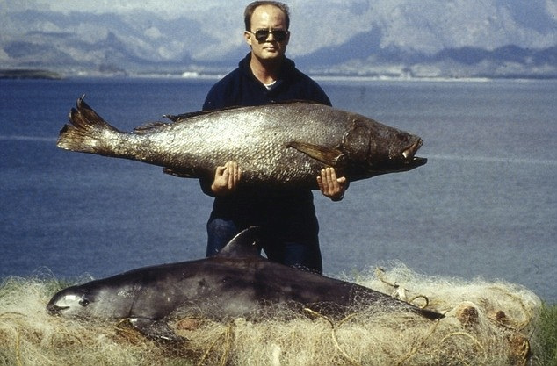
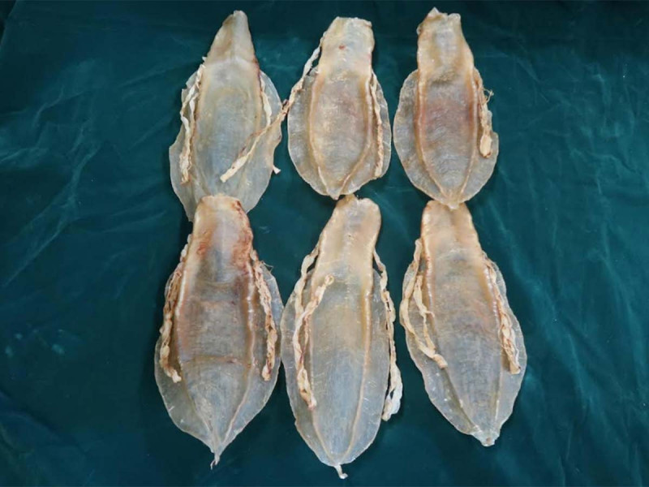
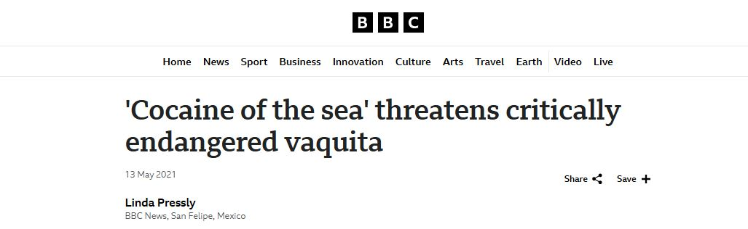
Meet Totoaba macdonaldi
Appendix
Notes:
Totoaba macdonaldi is an endemic croaker species from the Gulf of California in Mexico
Despite being protected under the Convention on International Trade in Endangered Species of Wild Fauna and Flora, it is actively poached, because of its swim bladder, which is extremely valuable (i.e. reaching 80,000$ a kilo)
As such, the trade is controled by organised groups, most likely the Sinaloa cartel
In doing so, it threatens the world’s smallest purpoise, the Vaquita, which has been driven close to (or even below) viability levels.

Slide 25




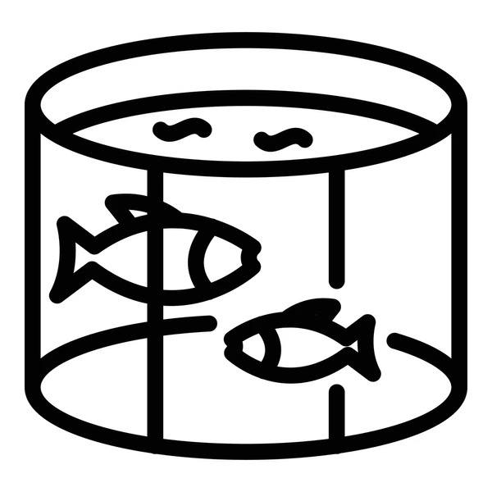
Curbing poaching with market based interventions in a strategic context
How will the totoaba population evolve under an illegal vertical monopoly?
How will the totoaba population evolve when farmed substitutes are legalized?
Market strategic interactions
Notes:
We use a three stage supply chain to describe the current situation, from Bulte and Damania :
First, fishermen fish where fishing is harder and harder as the population declines, so costs increase
They can only sell it to the cartel, who determines the price paid to poacher as it has more bargaining power
Finally, the cartel operates a monopoly on the consumer market
In this setting, farming provide an imperfect substitutes and competes on the end market with the cartel

Slide 26
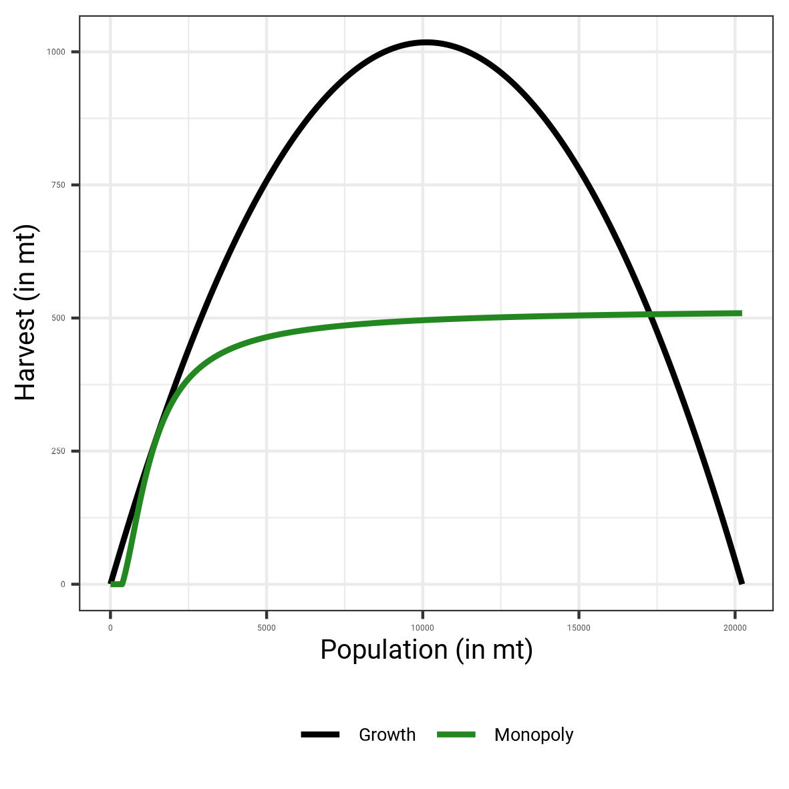
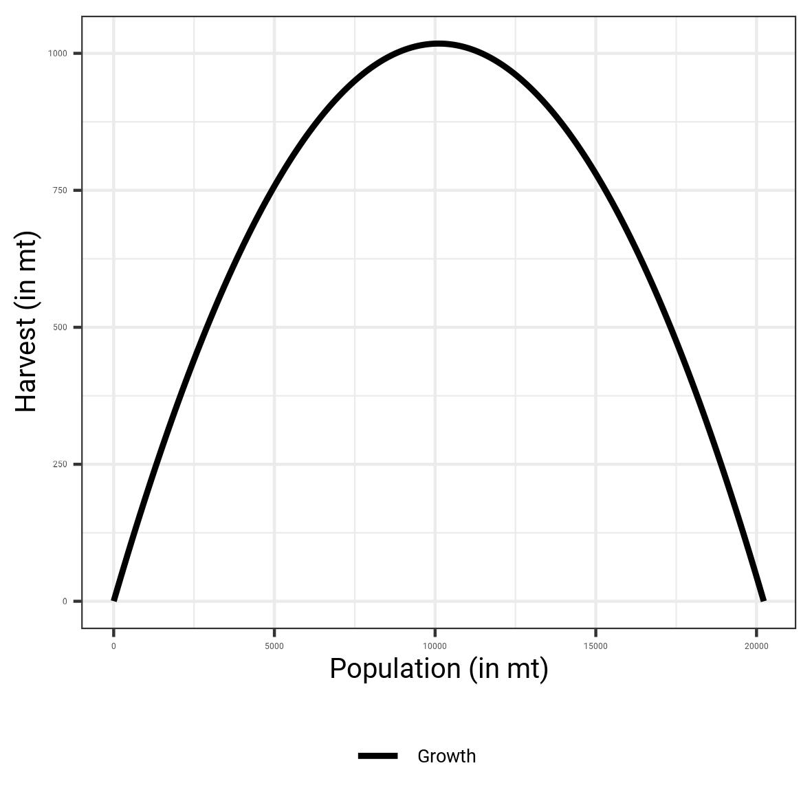
Vertical monopoly guarantees an uncertain, but large population
A vertical monopoly restricts its supply to enjoy large prices, resulting in large steady state population
However, a low steady state population is close from emerging
Notes:
We focus on the long term equilibrium of the fishery, where the growth of the fish stock equals its harvest
By finding the intersection between a harvest function that maximizes profits, and growth

Slide 27
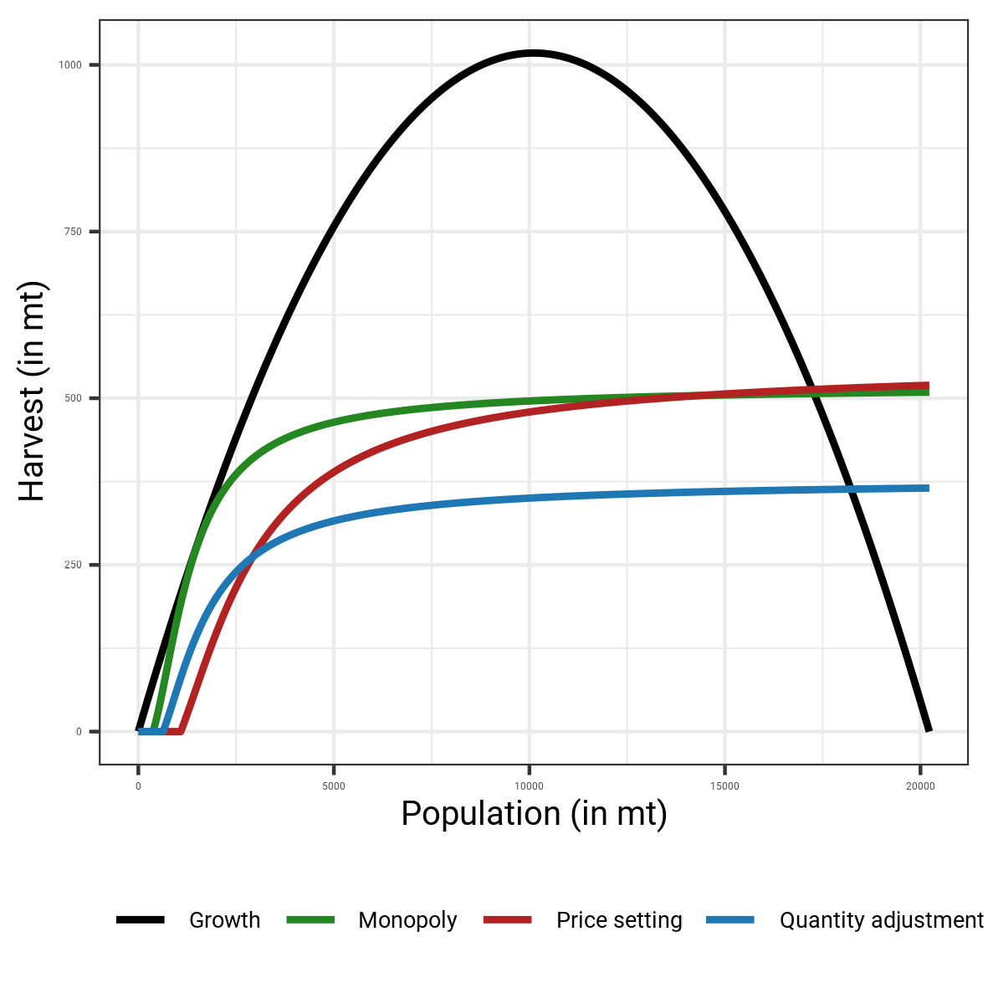
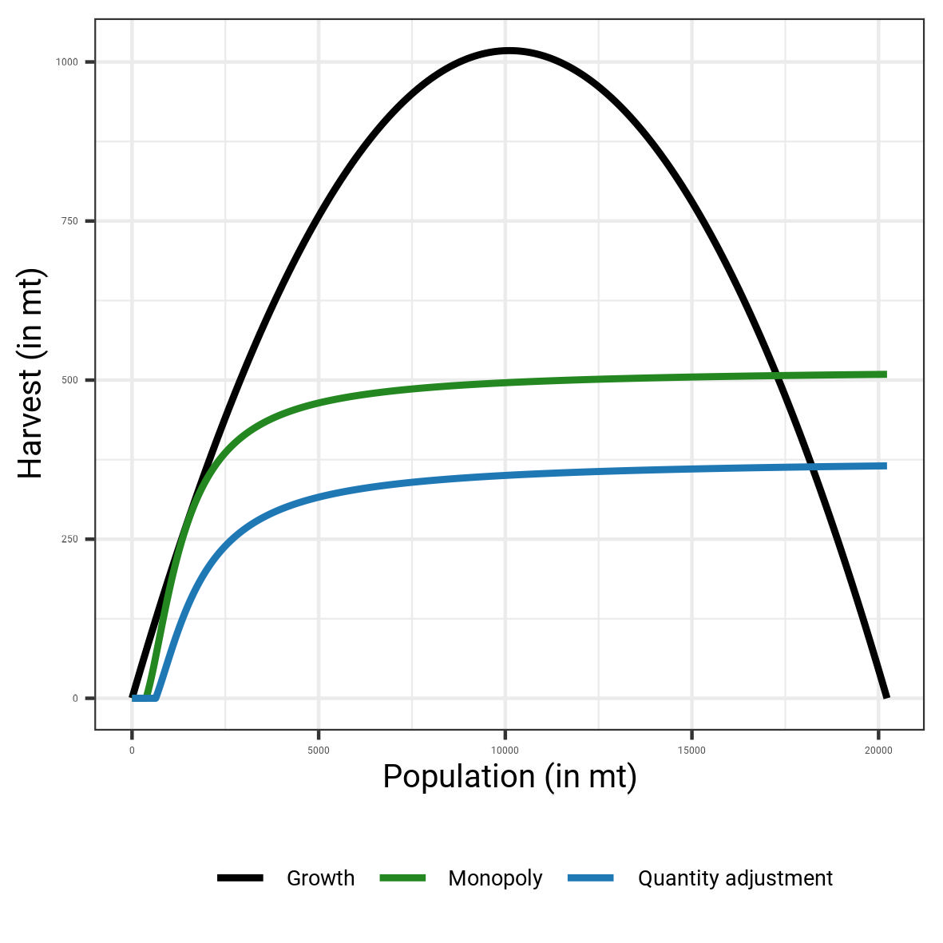
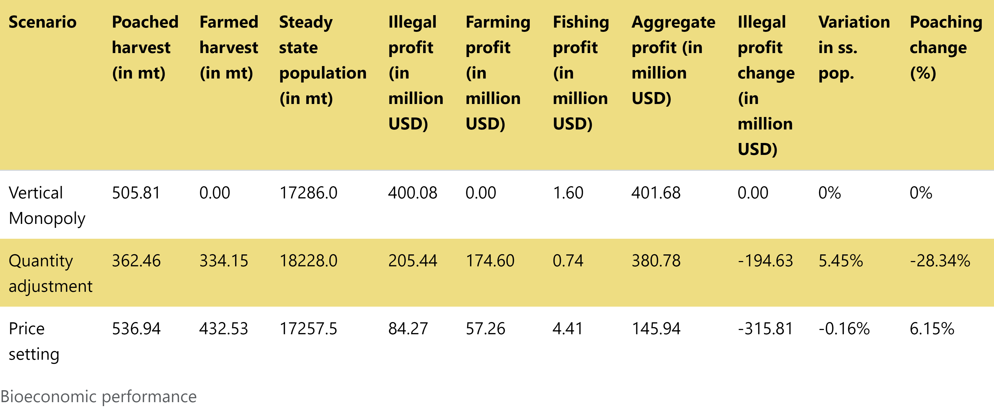
Introducing aquaculture generates conservation benefits
 | Poaching | Population | Illegal profit
Quantity adjustment | - 28% | +5% | - 195 million USD
Price war | +5% | -0,2% | - 315 million USD
Notes:
There are two ways for the aquaculture firm and the cartel to compete
Given that their products are substitutes (even if imperfectly), they both restric the quantities supplied, to enjoy large prices
In doing so, the market share of the cartel decreases, that of the aquaculture firm increases
This results in lower poaching, and increased farming activity
They can engage in a price war, to try to undercut each other:
In doing so, the fishing pressure increases, but not too much : the costs to fish increase as well, diminishing the cartel’s profits
This results in very low profits
Hence, the most likely outcome is the quantity adjustment

Slide 28

Results
Steady state population compared to vertical monopoly status quo
Other scenarios :
Several cartels operate the fishery
Cartel takes over the farming sector
Legalizing trade of farmed totoaba creates a parallel market
Demand increases
Demand increases a lot

Slide 29

Question: How will the totoaba population evolve under an illegal vertical monopoly? How will the totoaba population evolve when farmed substitutes are legalized?
Methods : Steady state fishery model with oligopolistic strategic interactions
Conclusions :
Vertical monopoly is not necessarily the conservationist’s best friend
Strategic interactions among final sellers do not necessarily lead to stock collapse, once technology and supply chain structure are considered
Market-based solutions, even imperfect, can help where bans are costly and moderately effective
Need integrated policies addressing demand evolution to guarantee conservation effects, and more info for policy effects
It may nonetheless be too late for the vaquita
Substantial gains and little downside from farming of Totoaba macdonaldi, w. J. Lawson (co-first author) A. Steinkruger, M.Castellanos-Rico, M.A.Cisneros-Mata, E. Aceves-Bueno, M.Warham, A. Sachs, S.Gaines, R&R at NPJ Ocean Sustainability
Appendix
Notes:
Point 2: compared to the literature, we show that […]

Slide 30
Conclusion

Slide 31
Key takeaways
Acknowledging the endogenous nature of spatial processes opens question for its optimal management
They stem from heterogeneities in environmental and/or economic underlying factors
Their management is not trivial and involves several layers : surface, connectivity
But can help reconciling different interests on land, if properly managed
Strategic interactions are key to understand the drivers of species decline
They can trigger races to the « bottom » in numerous settings
But can also be leveraged in the context of market-based conservation policies
Notes:
Here:
Strategic interactions are such that :
They sure can trigger race to the bottom, as illustrated in the literature.
However, they can also be leveraged for market based conservation policies
And policies to remedy the cause of strategic interactions, for example remedying spatial spillovers, may not be as intuitive as suppressing the spillover altogether. [TO REFINE]

Slide 32
Future research
Modeling the economics of connectivity is crucial :
Need to integrate larger scales and complex ecological dynamics for policy making
And increase efforts to include multiple species, with different contributions to people

Slide 33
Appendices
Chapter 1
Chapter 2
Chapter 3
Chapter 4

Slide 34
Chapter 1
Article selection and journal distribution
Methodological criteria
MCA and K-modes on individual articles
MCA – axis structure with variables contribution
Most represented lexical groups
Most represented words among methodological groups
A review of bioeconomic modeling on land Systematic methodological and narrative analysis Back to appendix list Back to chapter

Slide 35
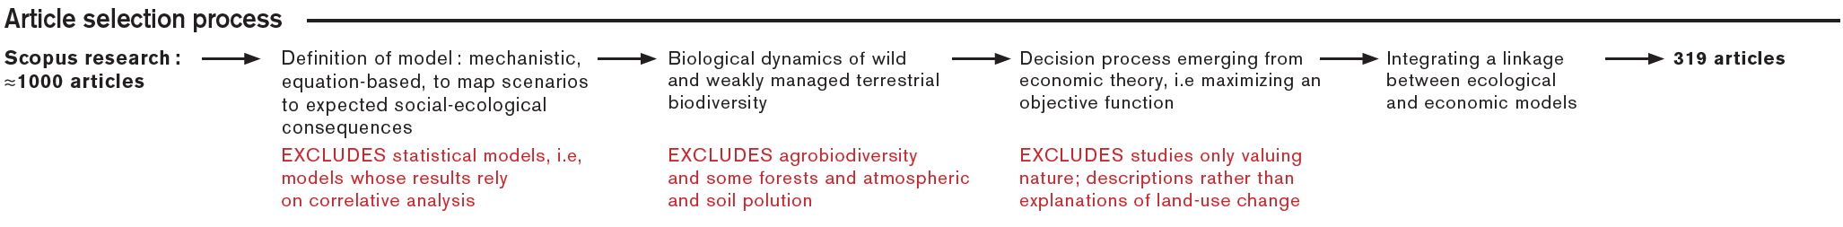
Field | Count | Percentage | Most represented journal | Most represented journal
Economics | 190 | 60 | Ecological Economics (44) | AJAE (19) & JEEM(19)
Ecology | 83 | 26 | Ecological Modeling (15) | Biological Conservation & Ecological Applications (11)
Sustainability Science | 34 | 10 | Natural Resource Modeling (10) | Agricultural Systems (3)
Applied Mathematics | 12 | 4 | Journal of Mathematical Analysis and Applications (2) | Journal of Mathematical Biology (2)
Back to chapter appendix

Slide 36
Biodiversity characterization | Biodiversity measure : per se, proxy | Proxy measure : not applicable, not specified, habitat, economic acticity, conservation budget | Biodiversity state variable: population, species, community, not specific
 | Type of diversity: functional, genetic, both | Biodiversity contribution level: single, multiple species, unknown
Ecological specifications | Dynamics : population, other | Spatiality : explicit, implicit, absent | Uncertainty : stochastic, deterministic
Economic specifications | Dynamics : static, dynamic | Spatiality: explicit, implicit, absent | Uncertainty: stochastic, deterministic
Bioeconomic linkage | Monetarization: yes/no | Bioeconomic problem: cost benefit, cost effectiveness | Biodiversity stake: constraint, objective, other
General characteristics | Solving method: closed form, numerical, both | Data: theoretical, empirical, both | Model use: normative, descriptive
 | Equilibrium: general, partial
Back to chapter appendix

Slide 37
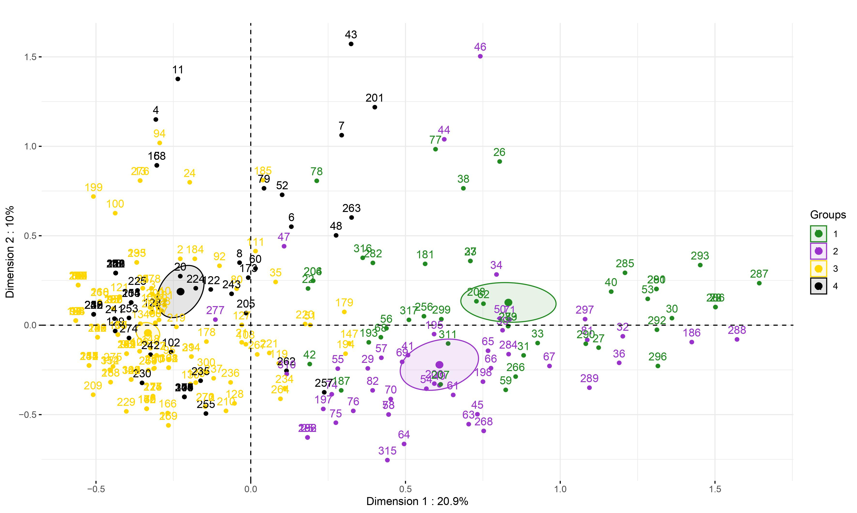
Back to chapter appendix

Slide 38
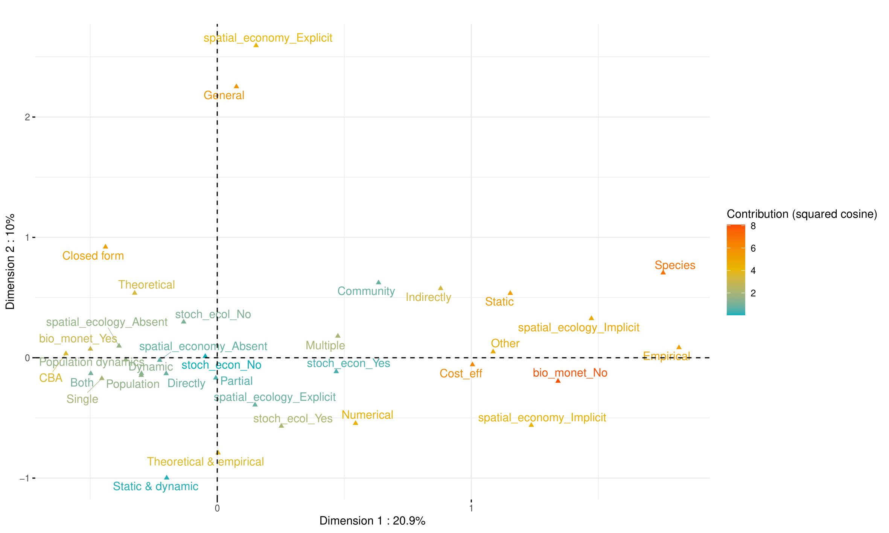
Back to chapter appendix

Slide 39
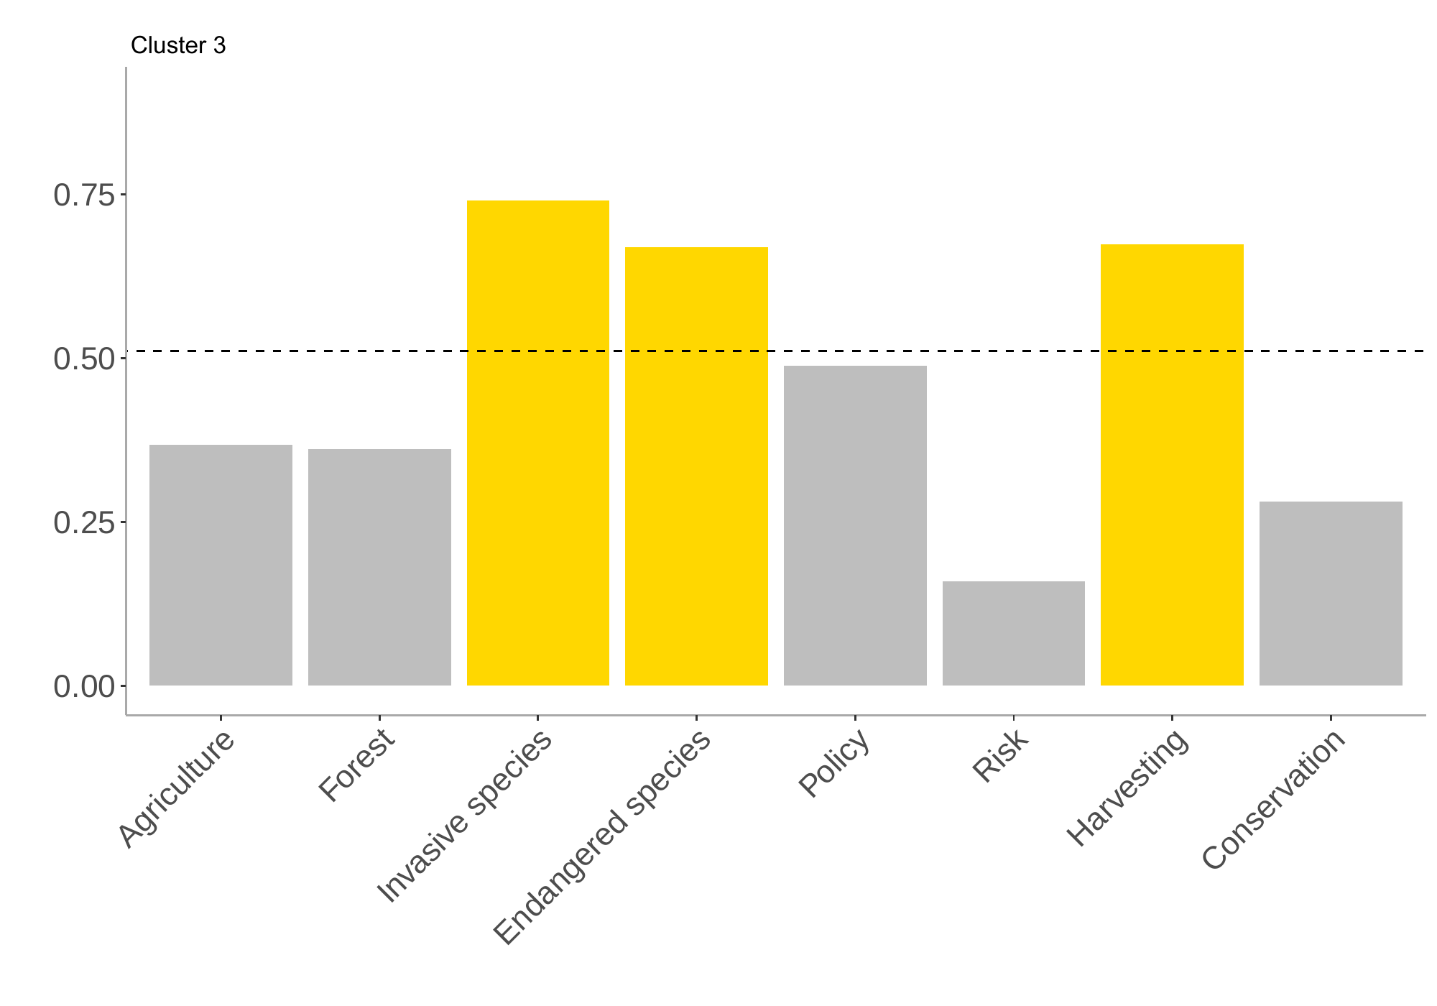
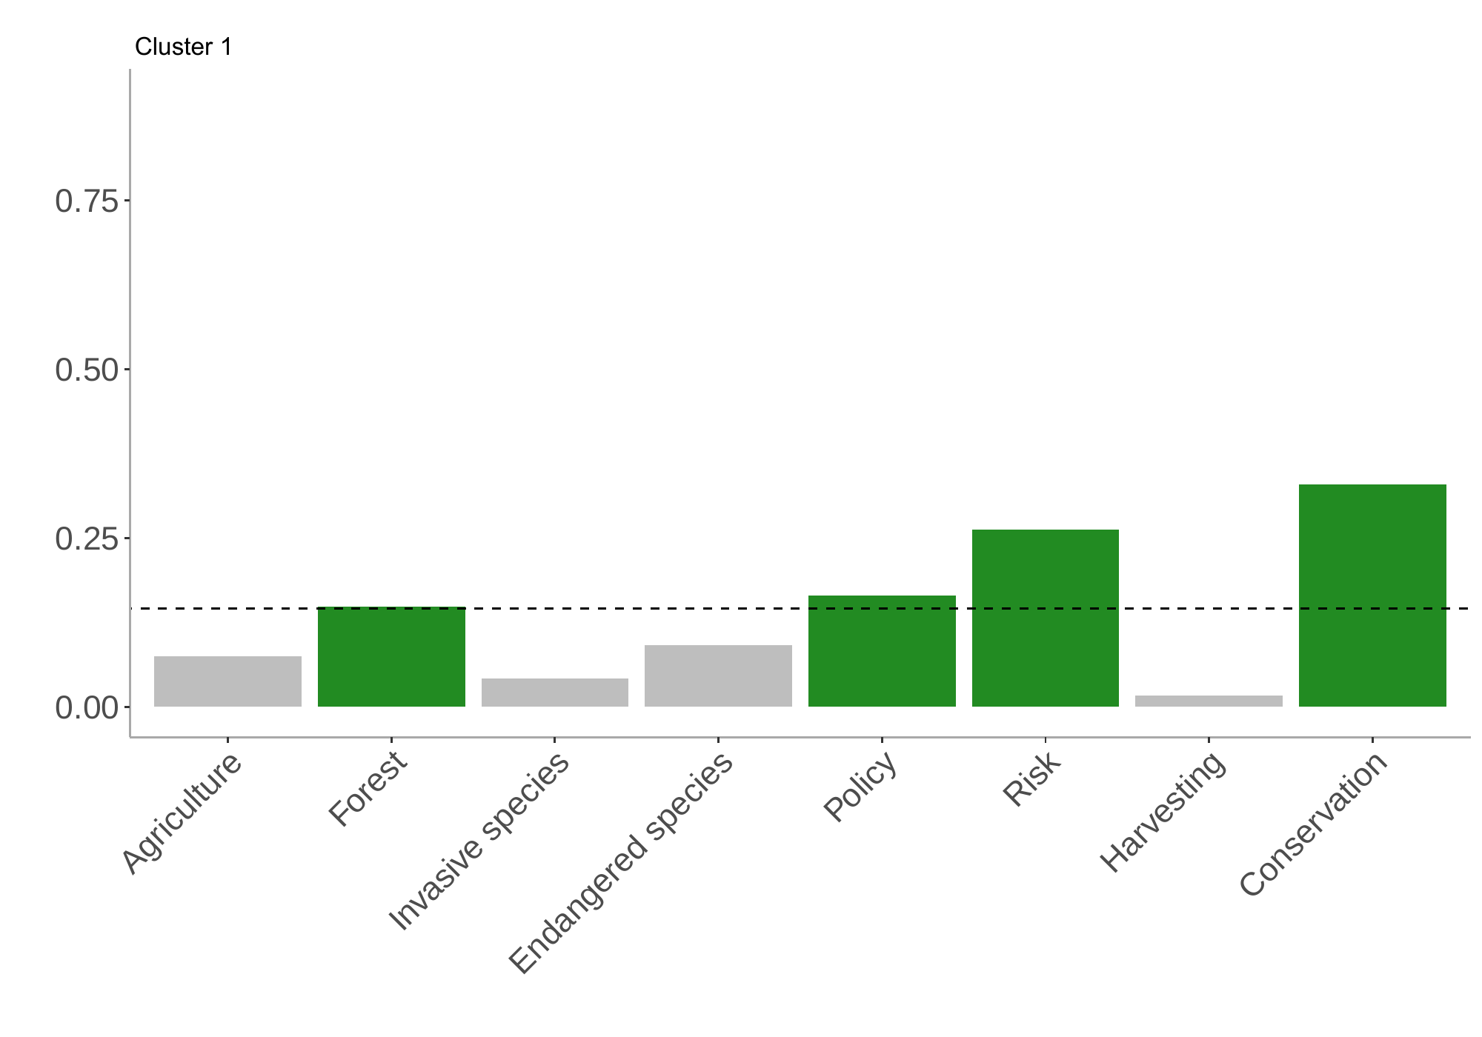
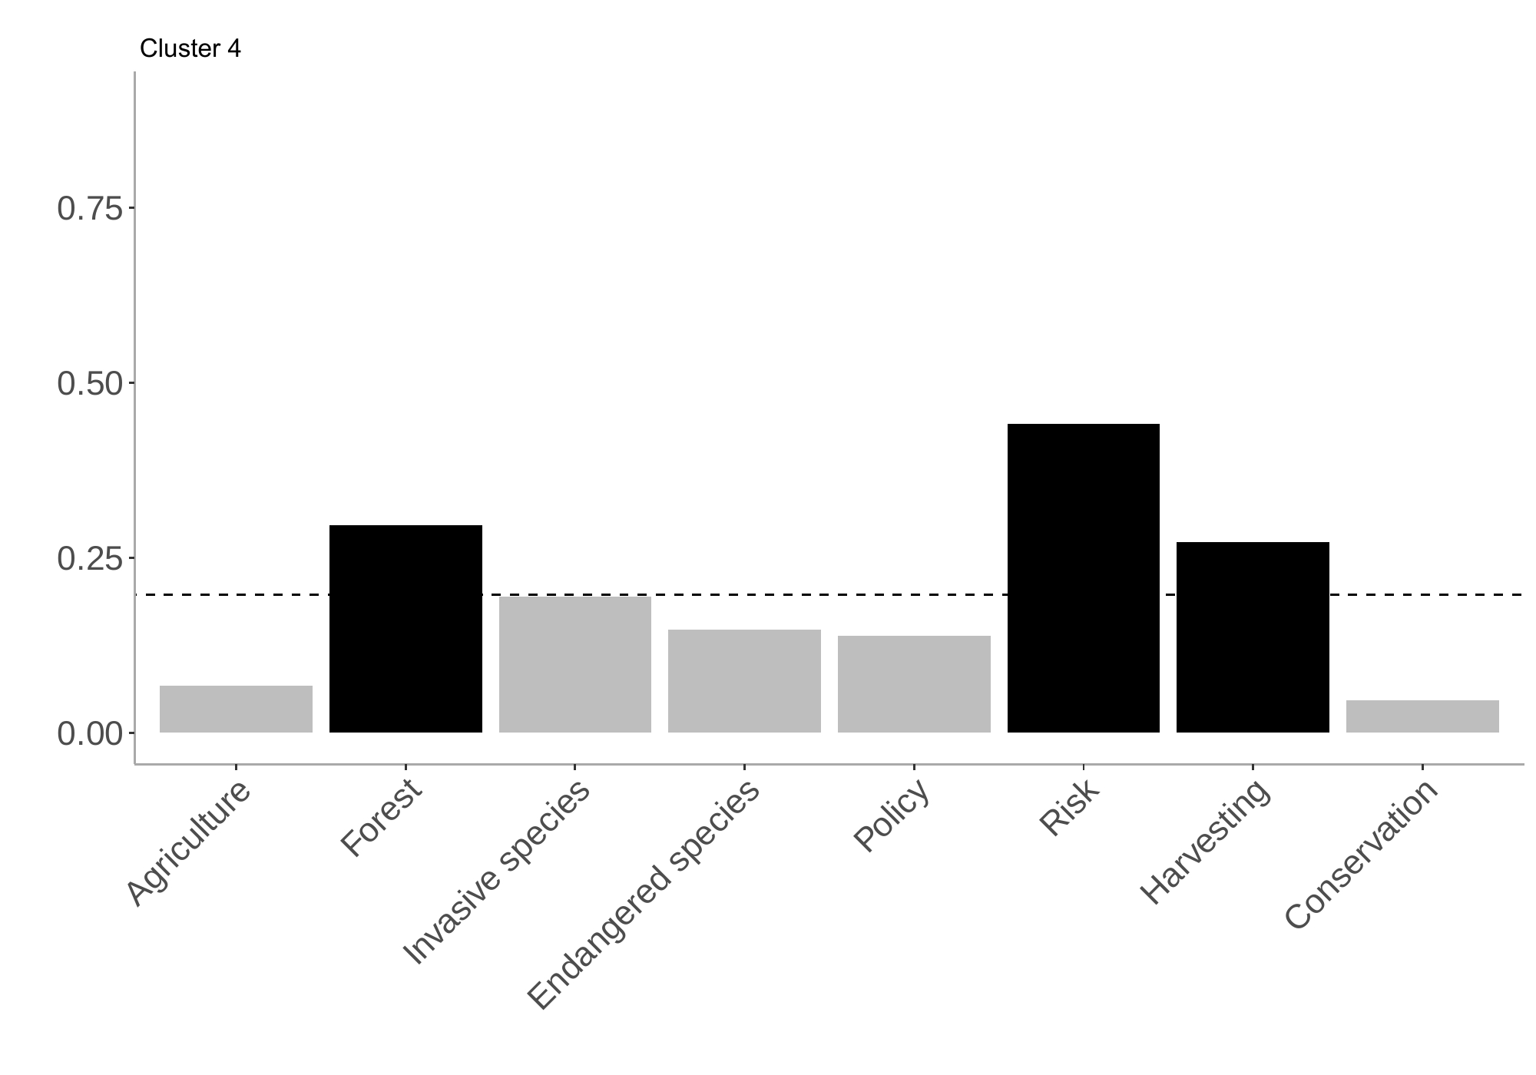
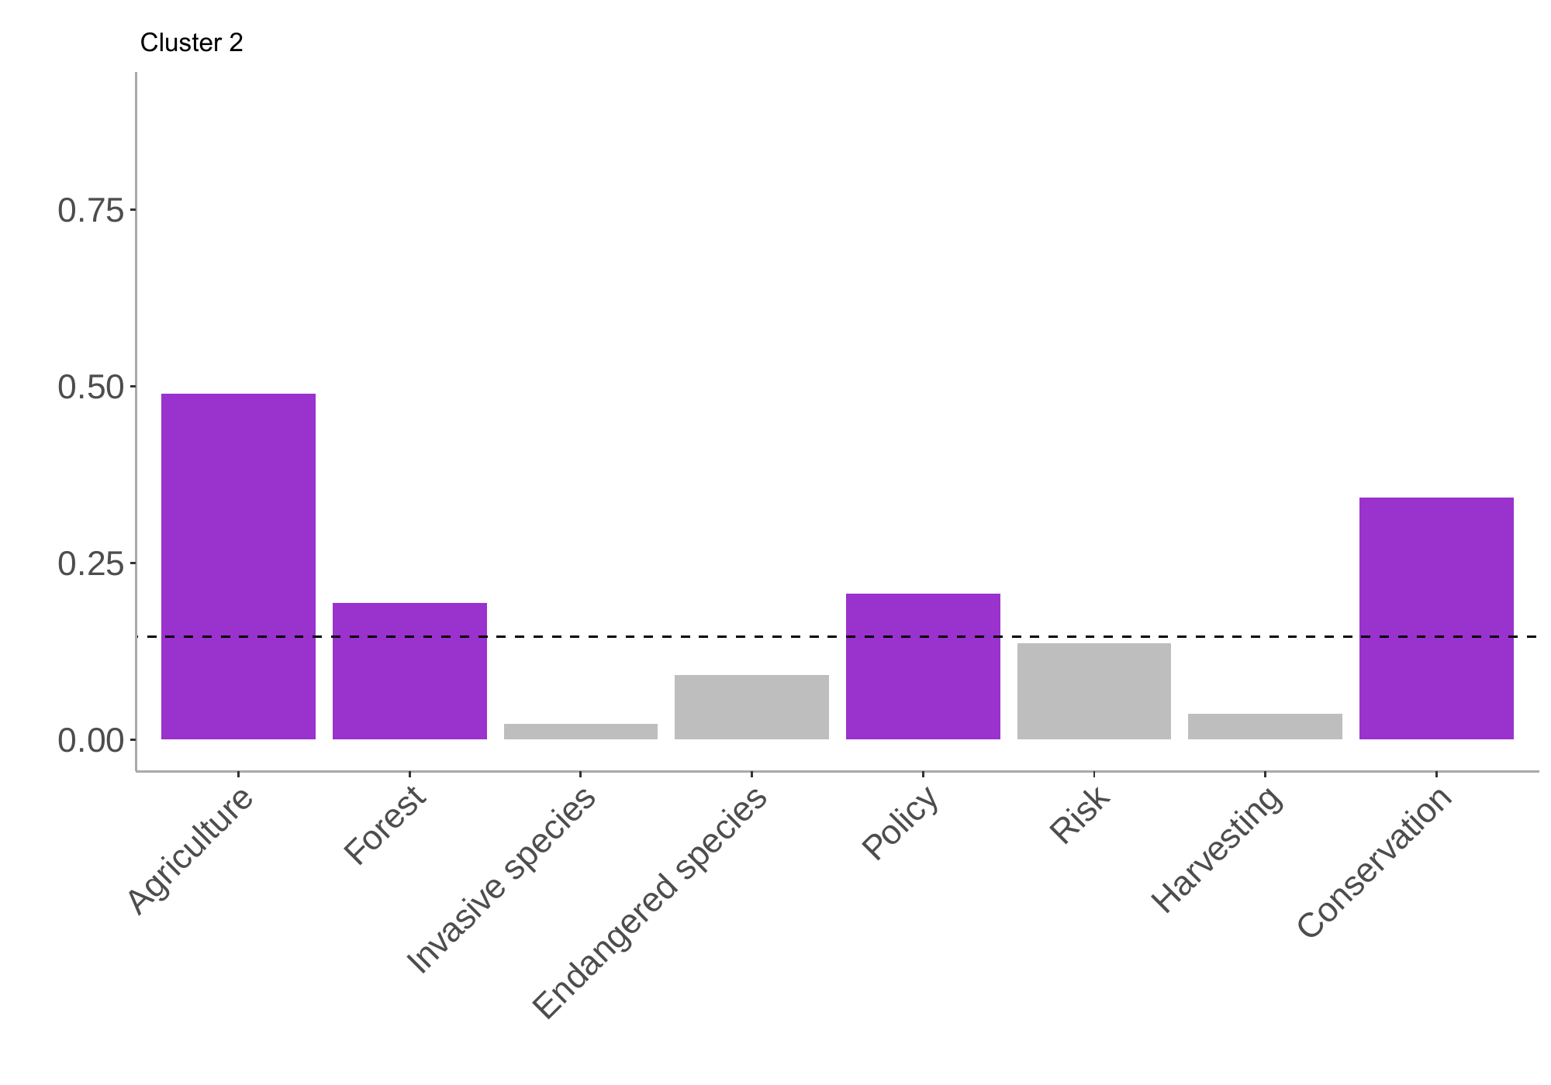
Back to chapter appendix

Slide 40
Agriculture : agriculture, agricultural, crop, rangeland, livestock, forage, fallow, farmland, grassland, oats, agri, farmers, grazing, crop, livestock, farming, wheat, crops, farm, cropping, rangeland, grazing, stocking, alfalfa, wheat, agro, crofting, pastures, ranchers, range, grasslands
Forest : Trees, stand, tree, forest, forestry, basal, spruce, even-aged, uneven-aged, forests, timber, diameter, wood, pine, faustmann, volume, reforestation, rotation, rotational, acacia,forested, lichen
Invasive species : Invasive species, invasive, rabies, invasion, invasivespecies, invader, coevolution, non-endemic, nis, eradication, pest, mountainpinebeetle,weevil, disease, gypsymoth, weevil, oats, weed, herbicide, invader, rabies, pathogens, invasivespecies, indigenous, barrier, infestation, alien, beaver, calvescens, eradicate, host, resistance, infestations, pesticide, pests, invasions, weed, weeds , pest, nonindigenous, pathogen, invaders, spartinaalterniflora, spartina, beetle, endemic, emeraldashborer, beetles, avena, rodent, serratedtussock, tuberculosis, miconiacalvescens, vaccine, insects, spread, vector-borne, epidemiology, quarantine, trap
Endangered/remarkable species : Endangered species, remarkable, trophy, tiger, endangeredspecies, warbler, moose, illegal, threatened, threats, endangered, elephants, butterfly, wildlife, game, poachers, wolf, reindeer, poaching, wolves, elephant, bushmeat, ivory, black, hunt, canislupus, hunters, bear, serengeti, tigers, deer, rhino, extinction, endangered
Policy : Policy, subsidy, tax, tradable, subsidies, instruments, policy, policies, payments, taxes, market, markets, incentives, payment, permits, taxes, incentive, funding, budget, budgets, conflict, conflicts, bonus, planner, taxation, property,market-based, contracts, interventions, intervention, strategy, propertyrights, taxsubsidy
Risk : risk, uncertainty, insurance, markov, option, resilience, stochastic, probabilities,uncertain
Conservation : conservation, park, reserve, sites, restoration, planning, conservationplanning
Harvesting : harvesting, harvests, harvest, hunting
Back to chapter appendix

Slide 41
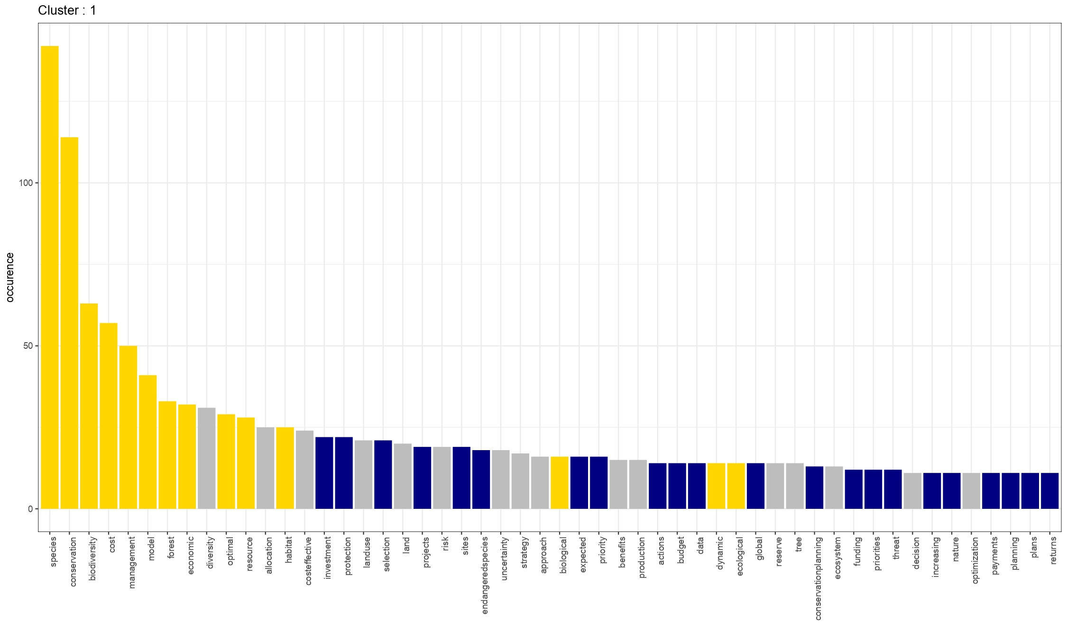
Back to chapter appendix

Slide 42
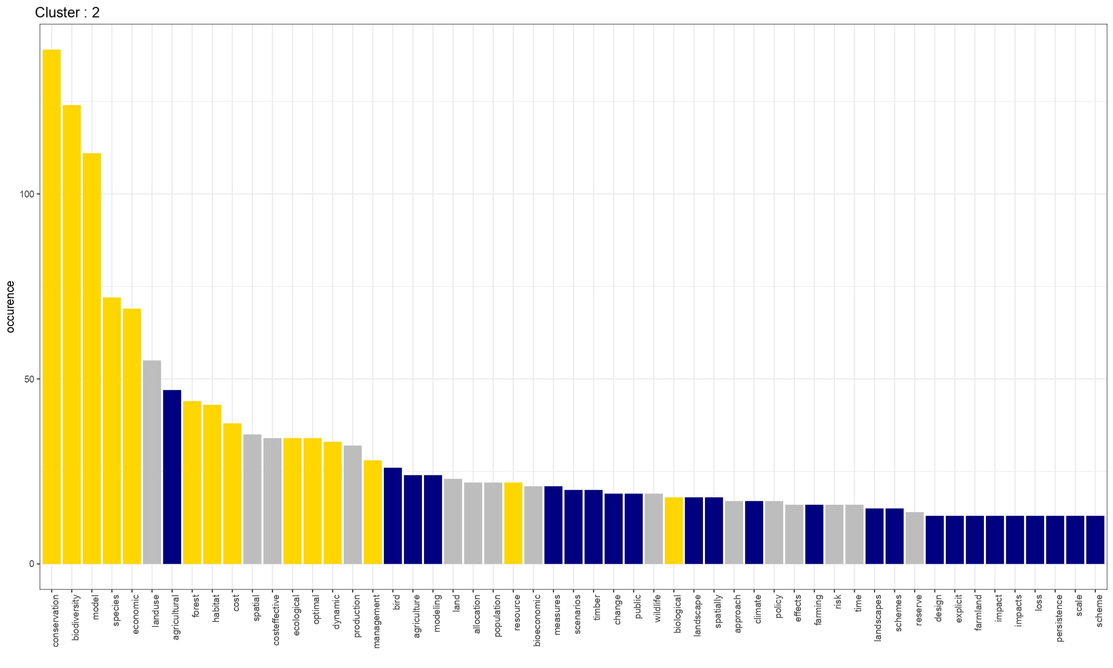
Back to chapter appendix

Slide 43
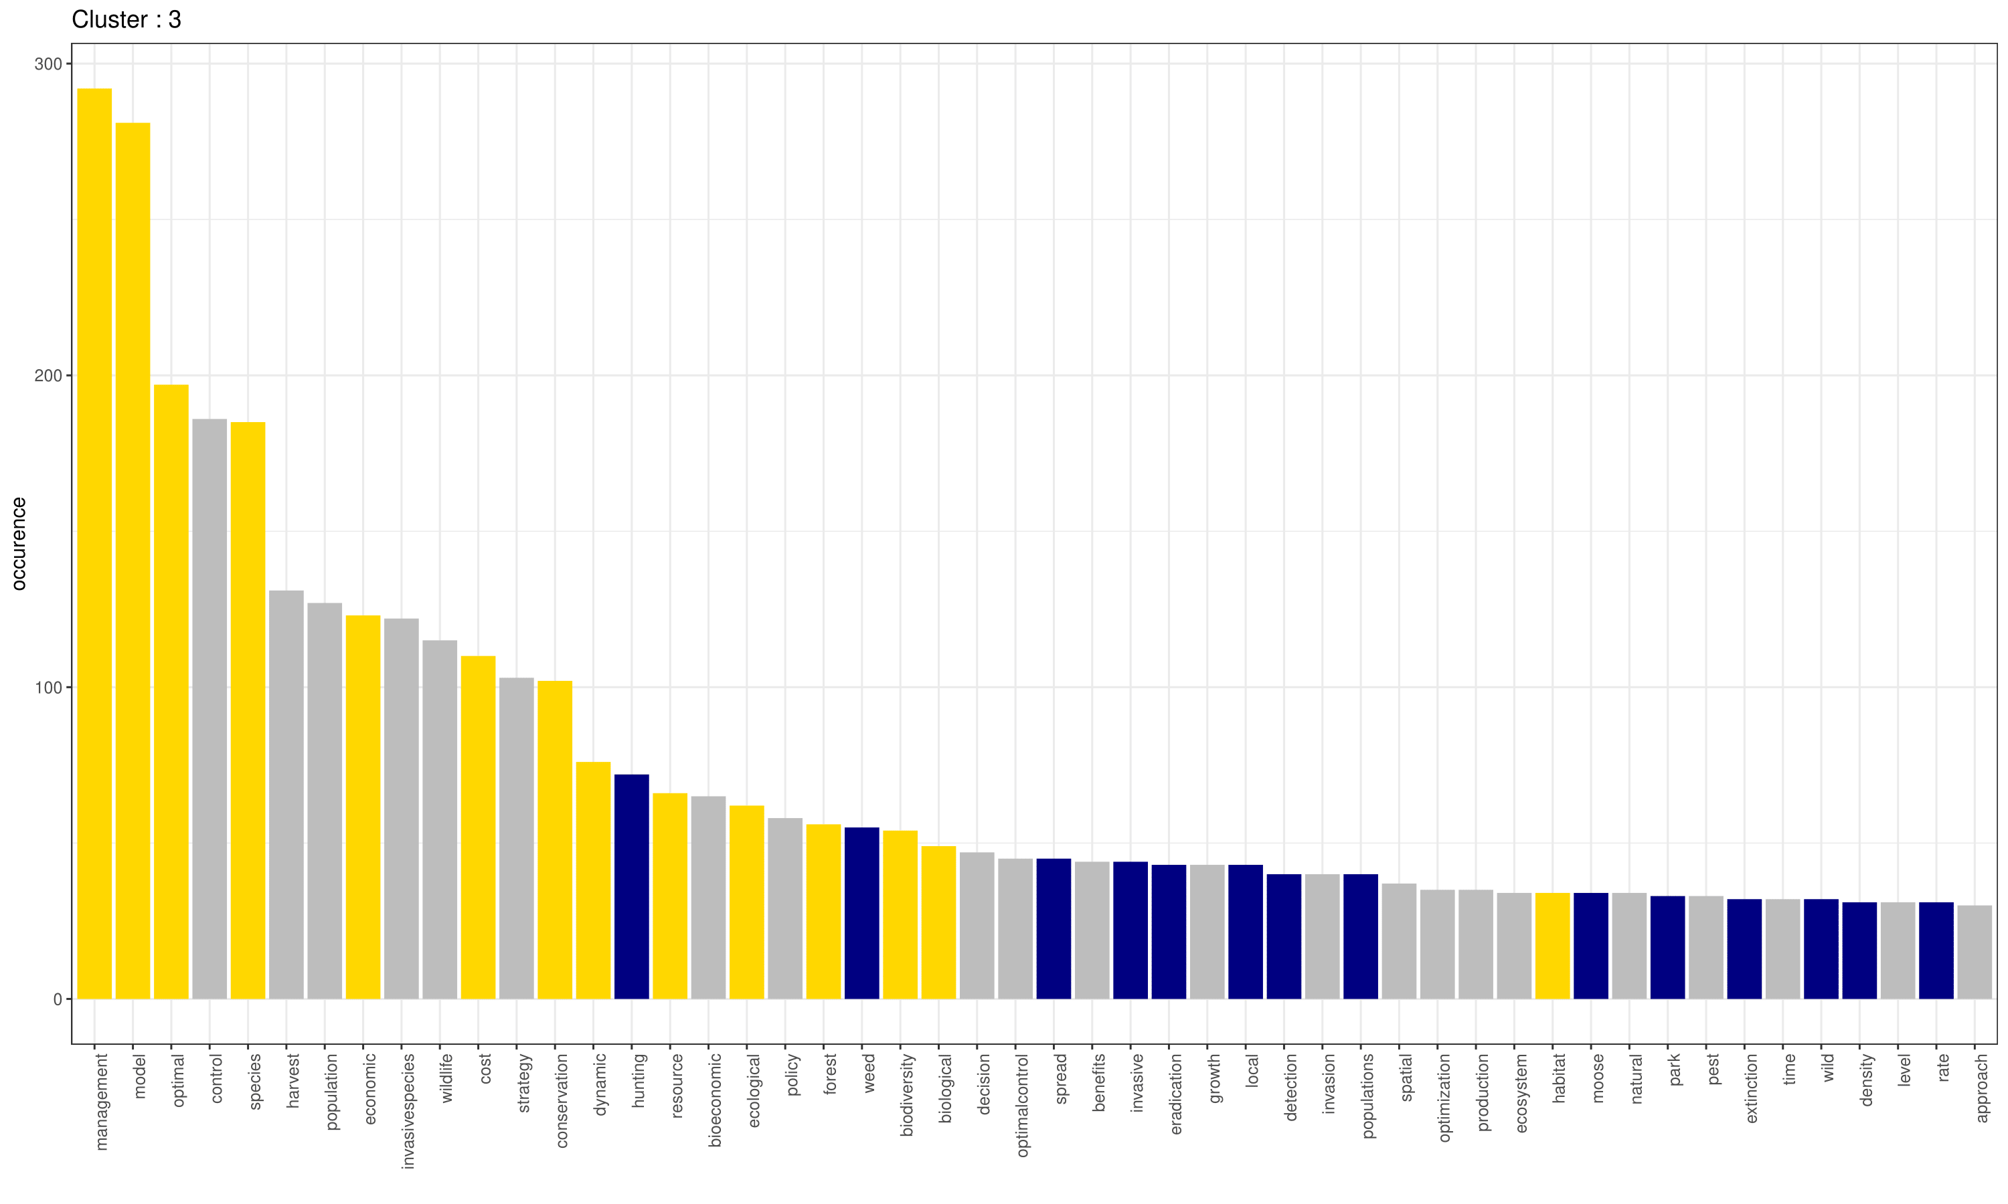
Back to chapter appendix

Slide 44
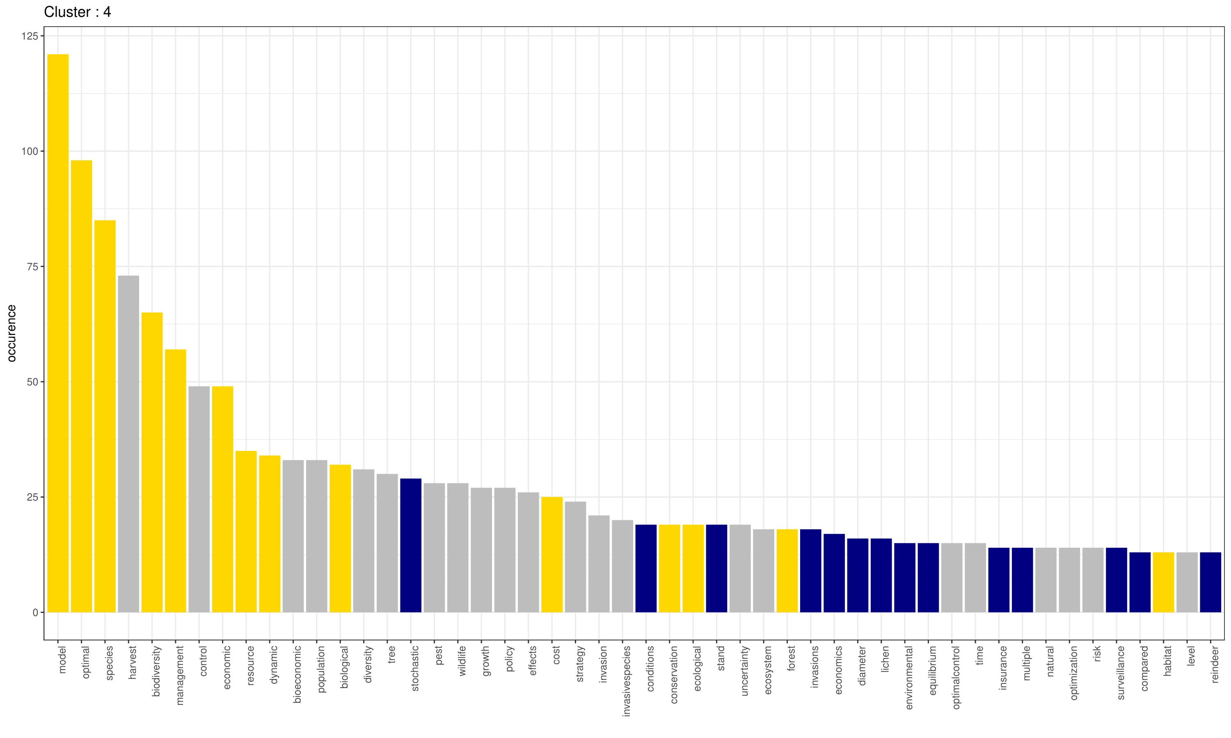
Back to chapter appendix

Slide 45
Chapter 2
How may size heterogeneity change the results
How may larger patches changes the results
To which extent may the size of patches become more important using your metric than the level of connectivity
To add :
Definition of the connectivity metric and how why we do it, in connection with Pascual Hortal
The types of empirical models we could plug with (i) cellular automaton et (ii) ellipse based spread.
How to manage spatial wildfire risks while safeguarding biodiversity? A graph theoretical approach to multi-objective spatial optimization
Back to appendix list Back to chapter

Slide 46
Global connectivity metric
Back to appendix list Back to chapter

Slide 47
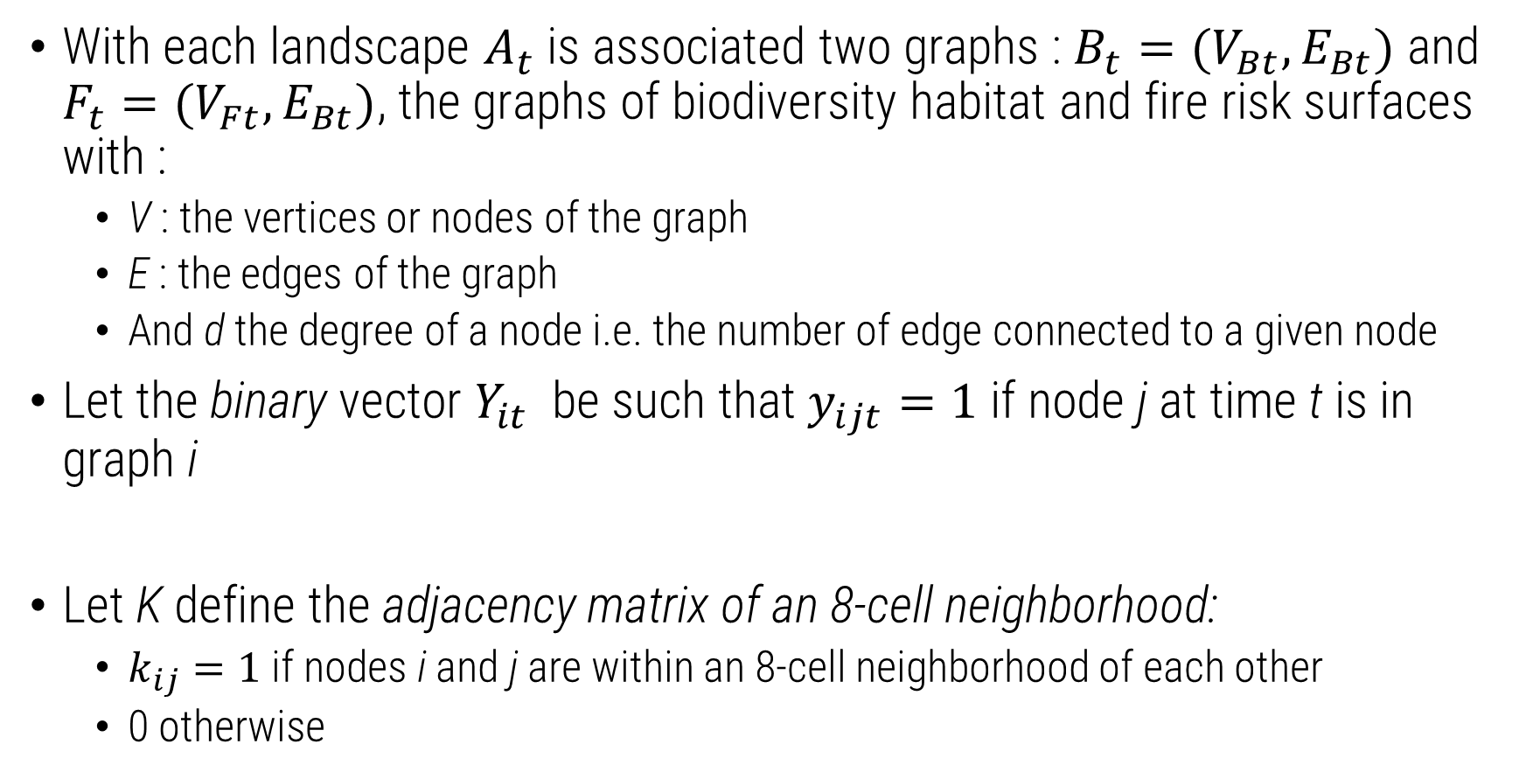
Set-up
With each landscape $A_{t}$ is associated two graphs : $B_{t}=(V_{Bt},E_{Bt})$ and $F_{t}=(V_{Ft},E_{Bt})$, the graphs of biodiversity habitat and fire risk surfaces with :
V : the vertices or nodes of the graph
E : the edges of the graph
And d the degree of a node i.e. the number of edge connected to a given node
Let the binary vector $Y_{it}$ be such that $y_{ijt}=1$ if node j at time t is in graph i
Let K define the adjacency matrix of an 8-cell neighborhood:
$k_{ij}=1$ if nodes i and j are within an 8-cell neighborhood of each other
0 otherwise

Slide 48
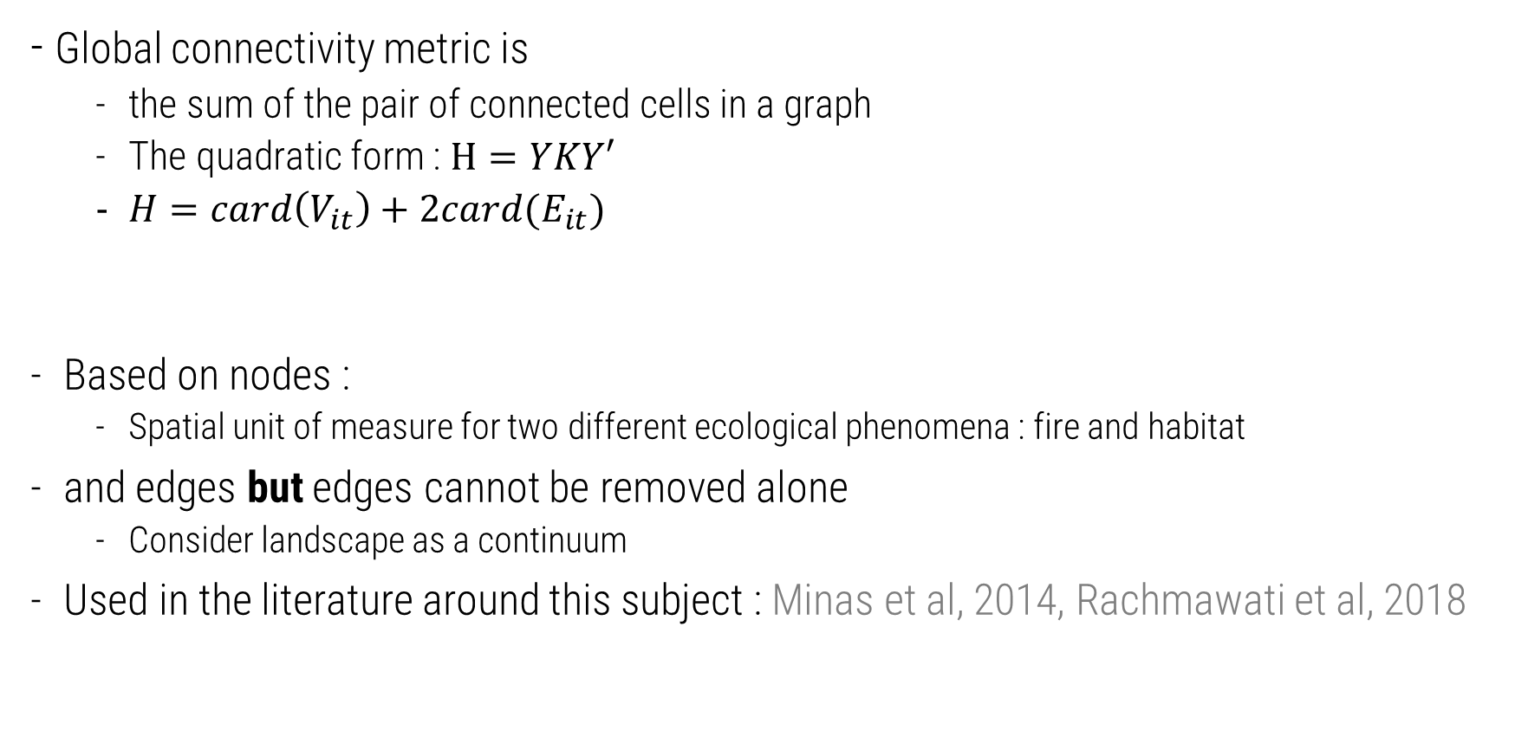
Definition
- Global connectivity metric is
the sum of the pair of connected cells in a graph
The quadratic form : $H=YKY′$
$H=card\left(V_{it}\right)+2card(E_{it})$
Based on nodes :
Spatial unit of measure for two different ecological phenomena : fire and habitat
and edges but edges cannot be removed alone
Consider landscape as a continuum
Used in the literature around this subject : Minas et al, 2014, Rachmawati et al, 2018

Slide 49
Properties
It features desirable properties for connectivity indices in landscape ecology (Pascual-Hortal and Saura, 2006), it diminishes with:
Loss of un/connected nodes :
Any loss of habitat is a problem
Loss of connected habitat is worse
Loss of cutpatch i.e. loss of inbetween patch
Loss of a component : if a collection of same size, connected nodes is lost, connectivity diminishes
Imagine a graph G=(V,E) such that H(G) = card(V) + 2card(E)
H(G’)=card(V)-1 + 2card(E)
H(G’)=card(V)-1 + 2card(E) - d
H(G’)=card(V)-1 + 2card(E) - d
H(G’)<H(G) - card(Vc) – Σ dc

Slide 50
Other results
Back to appendix list Back to chapter

Slide 51
Properties
Characterizations using other metrics :
Graph centrality
Landscape characteristics
Details on the optimization procedure
Details on the large scale landscapes

Slide 52
Properties
Characterizations using other metrics :
Graph centrality
Landscape characteristics
Details on the optimization procedure
Details on the large scale landscapes

Slide 53
Properties
Characterizations using other metrics :
Graph centrality
Landscape characteristics
Details on the optimization procedure
Details on the large scale landscapes

Slide 54
Extensions
Back to appendix list Back to chapter

Slide 55
Additional heterogeneity

Slide 56
Different spread : empirical wildfire spread models
Cell-based propagation in discretized landscapes
8 neighbor spread
Discretize continuous spread (Rothermel, 1972) : HFire (Peterson et al, 2008)
Cellular automaton approach with probabilistic dispersal : Fire2Cell (Pais et al, 2021)
Depending on wind pattern, fuel composition, weather, ruggedness
Less computationally intensive
Continuous space
Differential equations of fire front
Using elliptic spread following Rothermel, 1972
Examples include FARSITE (Finney et al, 1998) used by the USFS
Very computationally intensive and data dema nding, but mimics better physical processes (heat radiation etc)

Slide 57
Risk aversion in land planning

Slide 58
Chapter 3
Controling and fencing with invasive species Endogenizing species movement at the landscape scale
Back to appendix list Back to chapter

Slide 59
Chapter 4
Can farming save Totoaba macdonaldi, the cocaine of the sea? The effect of imperfect competition on the evolution of renewable resources
Back to appendix list Back to chapter
Notes:
Toutes les nouvelles analyses de sensibilité du papier, et voir les chiffres sur les stated preferences, peut être les articles qu’on nous a envoyé au sujet des vietnamiens.

Slide 60
Theoretical model
Back to appendix list Back to chapter
Notes:
Toutes les nouvelles analyses de sensibilité du papier, et voir les chiffres sur les stated preferences, peut être les articles qu’on nous a envoyé au sujet des vietnamiens.

Slide 61
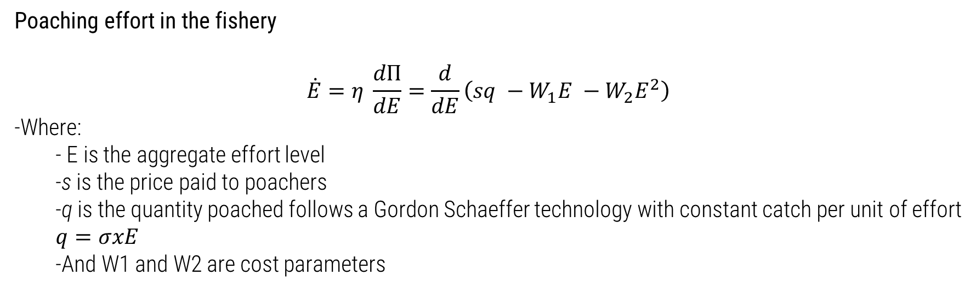
Fishery dynamics
Same theoretical model as Bulte and Damania (2007) but :
We change the cost structure to reflect the aggregate dynamics of the fishery (see Clark, 2007 and Tromeur et al, 2021)
Reach different conclusions from the original article with identical framework
Poaching effort in the fishery
$$\dot{E}=η \frac{dΠ}{dE}=\frac{d}{dE}\left(sq −W_{1}E −W_{2}E^{2}\right)$$
Where:
E is the aggregate effort level
s is the price paid to poachers
q is the quantity poached follows a Gordon Schaeffer technology with constant catch per unit of effort $q=σxE$
And W1 and W2 are cost parameters

Slide 62
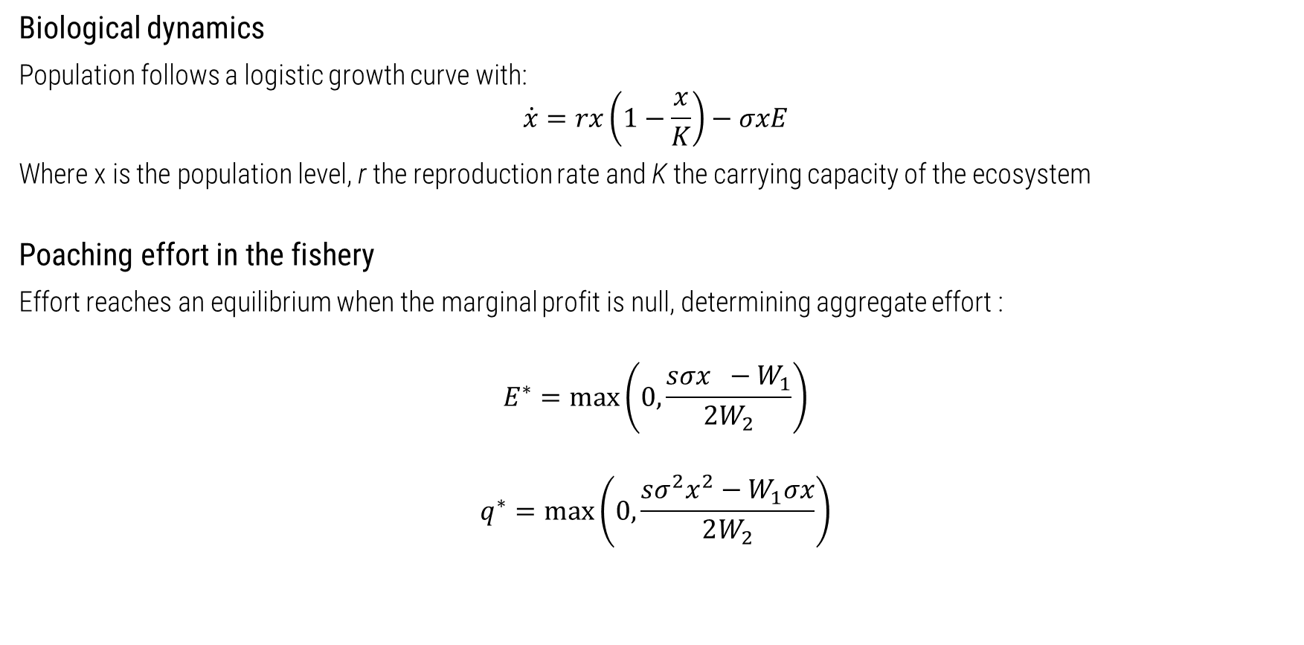
Fishery dynamics (2)
Biological dynamics
Population follows a logistic growth curve with:
$$\dot{x}=rx\left(1−\frac{x}{K}\right)−σxE$$
Where x is the population level, r the reproduction rate and K the carrying capacity of the ecosystem
Poaching effort in the fishery
Effort reaches an equilibrium when the marginal profit is null, determining aggregate effort :
$$E^{∗}=\max\left(0, \frac{sσx −W_{1}}{2W_{2}}\right)$$
$$q^{∗}=max\left(0, \frac{sσ^{2}x^{2}−W_{1}σx}{2W_{2}}\right)$$

Slide 63
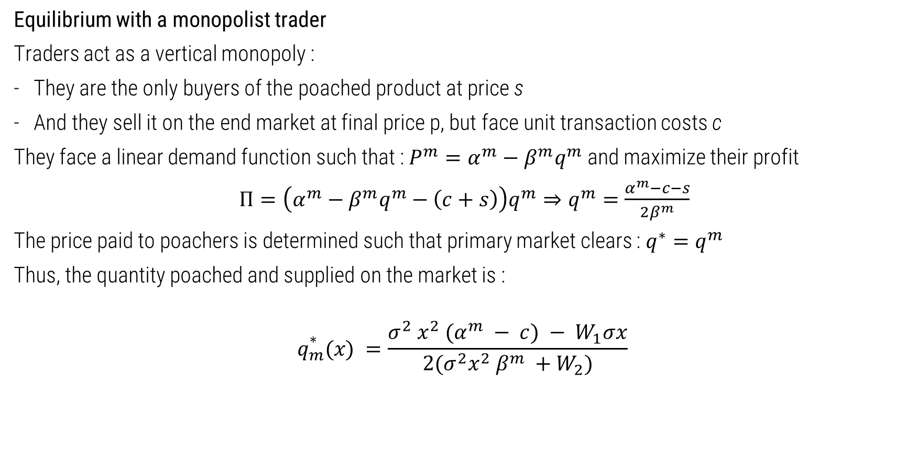
Monopolist trader
Equilibrium with a monopolist trader
Traders act as a vertical monopoly :
They are the only buyers of the poached product at price s
And they sell it on the end market at final price p, but face unit transaction costs c
They face a linear demand function such that : $P^{m}=α^{m}−β^{m}q^{m}$ and maximize their profit
$Π=\left(α^{m}−β^{m}q^{m}−\left(c+s\right)\right)q^{m}⇒q^{m}=\frac{α^{m}−c−s}{2β^{m}}$
The price paid to poachers is determined such that primary market clears : $q^{∗}=q^{m}$
Thus, the quantity poached and supplied on the market is :
$$q_{m}^{∗}(x) =\frac{σ^{2} x^{2} (α^{m} − c) − W_{1}σx}{2(σ^{2}x^{2} β^{m} +W_{2})}$$

Slide 64
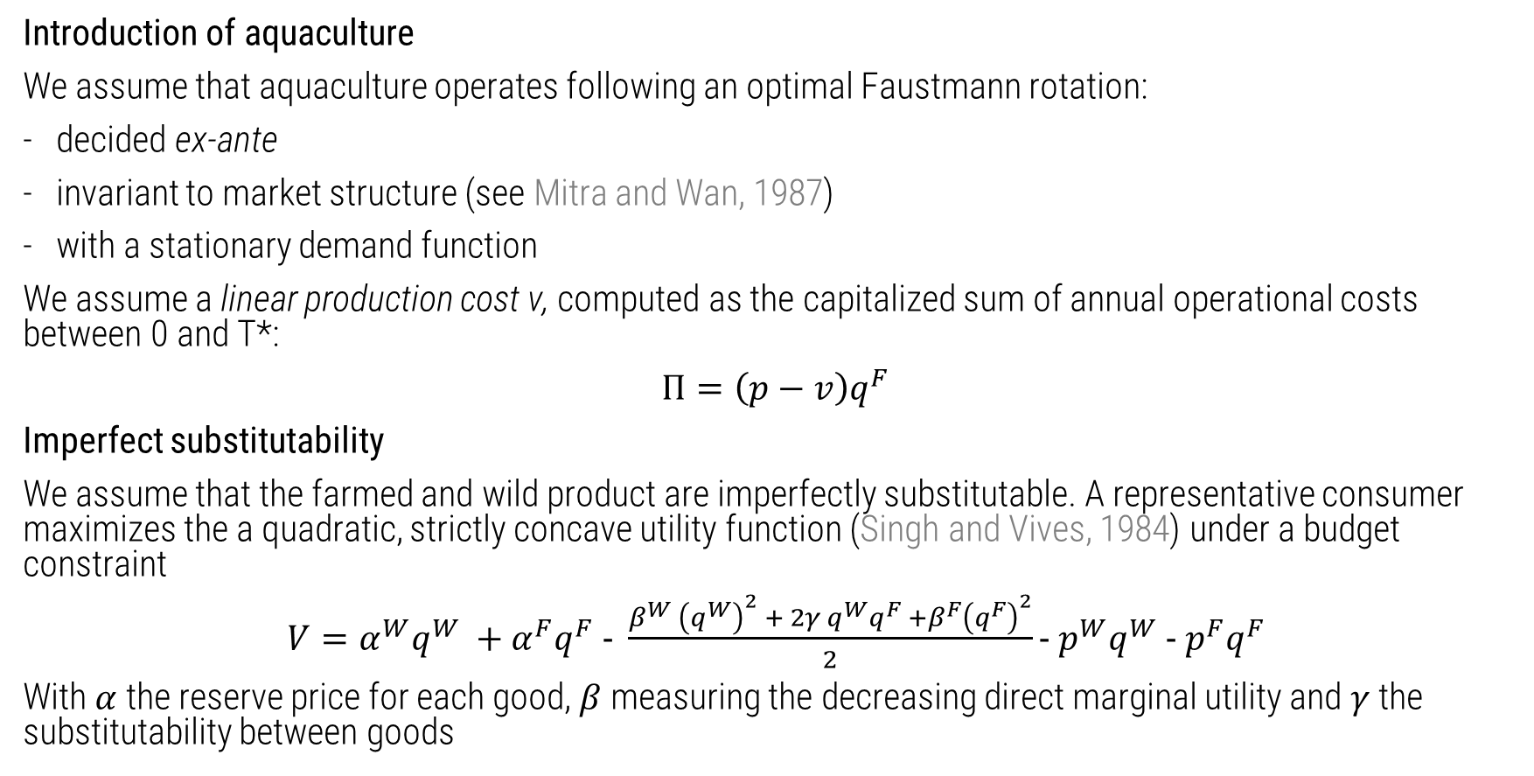
Aquaculture and imperfect substitutability
Introduction of aquaculture
We assume that aquaculture operates following an optimal Faustmann rotation:
decided ex-ante
invariant to market structure (see Mitra and Wan, 1987)
with a stationary demand function
We assume a linear production cost v, computed as the capitalized sum of annual operational costs between 0 and T*:
$Π=\left(p−v\right)q^{F}$
Imperfect substitutability
We assume that the farmed and wild product are imperfectly substitutable. A representative consumer maximizes the a quadratic, strictly concave utility function (Singh and Vives, 1984) under a budget constraint
$V=α^{W}q^{W} +α^{F}q^{F} − \frac{β^{W} {\left(q^{W}\right)}^{2} + 2γ q^{W}q^{F} +β^{F}{\left(q^{F}\right)}^{2}}{2}− p^{W}q^{W} − p^{F}q^{F}$
With $α$ the reserve price for each good, $β$ measuring the decreasing direct marginal utility and $γ$ the substitutability between goods

Slide 65
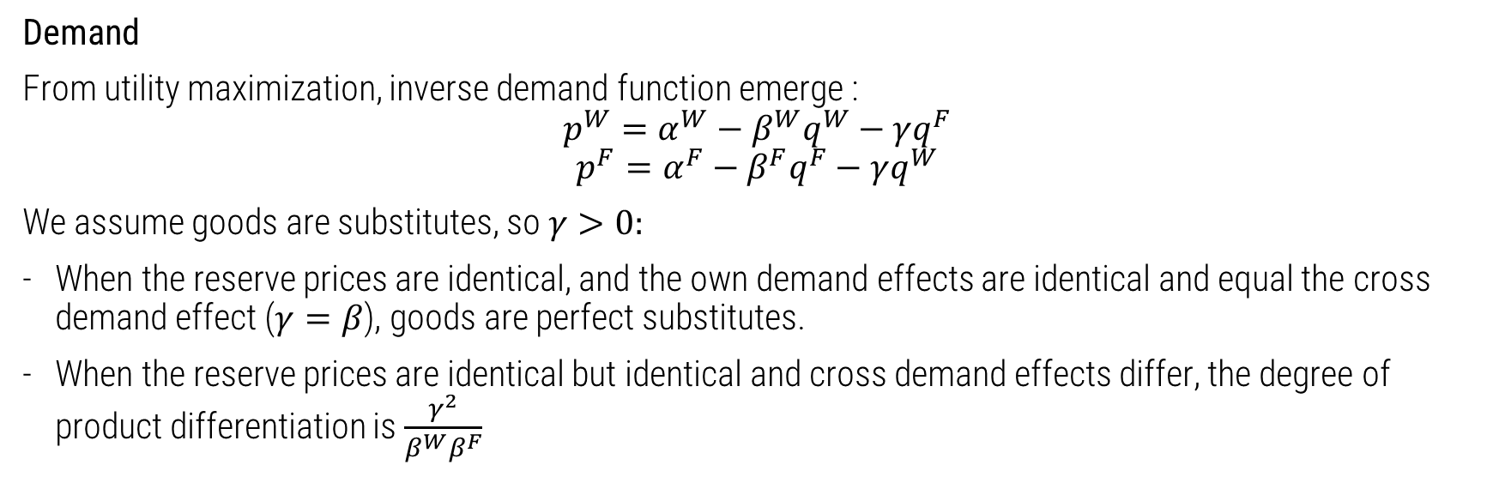
Aquaculture and imperfect substitutability (2)
Demand
From utility maximization, inverse demand function emerge :
$$p^{W}=α^{W}−β^{W}q^{W}−γq^{F}$$
$$p^{F}=α^{F}−β^{F}q^{F}−γq^{W}$$
We assume goods are substitutes, so $γ>0:$
When the reserve prices are identical, and the own demand effects are identical and equal the cross demand effect ($γ=β$), goods are perfect substitutes.
When the reserve prices are identical but identical and cross demand effects differ, the degree of product differentiation is $\frac{γ^{2}}{β^{W}β^{F}}$

Slide 66
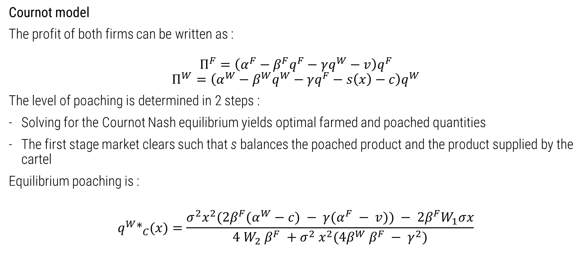
Imperfect competition – Cournot competition
Cournot model
The profit of both firms can be written as :
$$Π^{F}=\left(α^{F}−β^{F}q^{F}−γq^{W}−v\right)q^{F}$$
$$Π^{W}=\left(α^{W}−β^{W}q^{W}−γq^{F}−s\left(x\right)−c\right)q^{W}$$
The level of poaching is determined in 2 steps :
Solving for the Cournot Nash equilibrium yields optimal farmed and poached quantities
The first stage market clears such that s balances the poached product and the product supplied by the cartel
Equilibrium poaching is :
$$q^{W}∗_{C}(x)=\frac{σ^{2}x^{2}(2β^{F}(α^{W}−c) − γ(α^{F} − v)) − 2β^{F}W_{1}σx}{4 W_{2} β^{F} +σ^{2} x^{2}(4β^{W} β^{F} − γ^{2})}$$

Slide 67
Imperfect competition – Cournot competition
Cournot model
Lemma 1: Assume the market is large, i.e., the residual demand for large stock levels is large enough. For any given wildlife stock, poaching levels in equilibrium with captive breeding will be lower than those without captive breeding, if the introduction of captive-bred animal products has no impact on the parameters of the original inverse demand function for wild animal products
Proof (intuition) : to ensure a lower harvest, it must be that farming is relatively competitive with poaching.
The market needs to be truly duopolistic :
- the unit cost of farming must not exceed the choke price
- If poachers could not manage the stock such that they depress demand so much as to kick their competitor out of the market
Cournot competition unambiguously leads to lower poaching levels than a monopoly does
This is true in our empirical set-up.

Slide 68
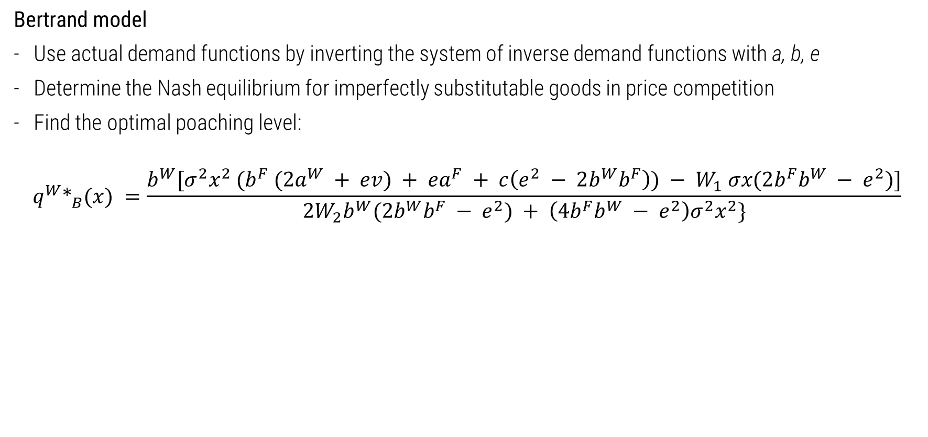
Imperfect competition – Bertrand competition
Bertrand model
Use actual demand functions by inverting the system of inverse demand functions with a, b, e
Determine the Nash equilibrium for imperfectly substitutable goods in price competition
Find the optimal poaching level:
$$q^{W}∗_{B}(x) =\frac{b^{W}[σ^{2}x^{2} (b^{F} (2a^{W} + ev) + ea^{F} + c\left(e^{2} − 2b^{W}b^{F}\right)) − W_{1} σx(2b^{F}b^{W} − e^{2})]}{2W_{2}b^{W}(2b^{W}b^{F} − e^{2}) + \left(4b^{F}b^{W} − e^{2}\right)σ^{2}x^{2}\}}$$

Slide 69
Imperfect competition – Bertrand competition (2)
Bertrand model
Lemma 2 : with Bertrand competition, if the introduction of captive-bred products has no impact on the parameters of the demand function for wild animal products, poaching levels with captive breeding are ambiguous. The driver of the equilibrium is the cost ratio between aquaculture and the illegal poaching sector, i.e v and c + s(x):
For relatively low ratio values (i.e, c + s(x) >> v), poaching is unambiguously lower than without captive breeding for any given wildlife stock Intuition : if farming can vastly undercut the cartel, while being profitable, even if the products are imperfectly substitutable, this reduces poaching as the residual demand is low.

Slide 70
Imperfect competition – Bertrand competition (3)
Bertrand model
For intermediate ratio values, poaching is lower, then larger, than without captive breeding Intuition: at low stock levels, the price of poached product is large, making it less competitive, and reducing the potential harvest. At larger population levels, the cost of fishing is lower, while the farming cost may remain large, thus providing an opportunity to increase poaching and engaging in a price war
For large values of unit farming costs, poaching is unambiguously larger than without captive breeding for any wildlife stocks Intuition : if farming is very costly, the cartel can increase poaching and undercut the farming sector, thus causing more harvest at any stock level.

Slide 71
Model extensions
Back to appendix list Back to chapter
Notes:
Toutes les nouvelles analyses de sensibilité du papier, et voir les chiffres sur les stated preferences, peut être les articles qu’on nous a envoyé au sujet des vietnamiens.

Slide 72
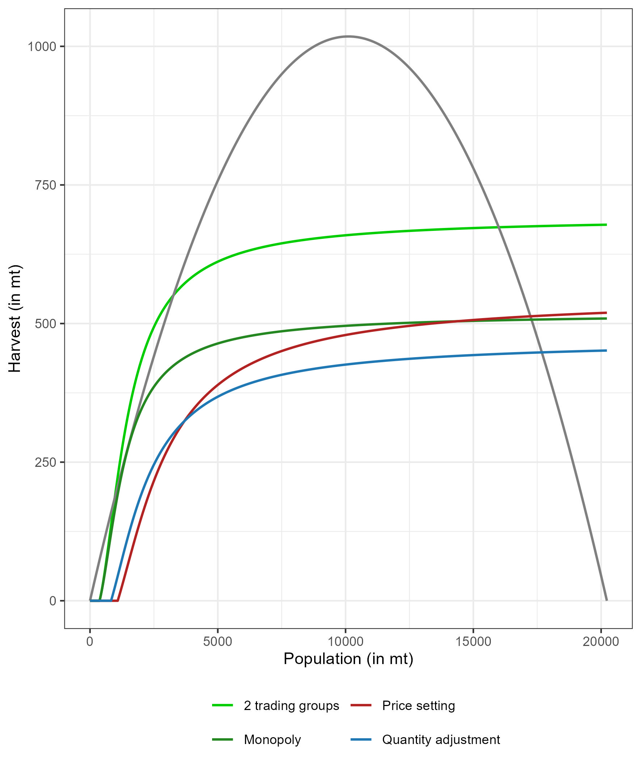
Oligopoly model : many farmers, many traders.
Assume N traders, identical
Increased competition results in increased poaching pressure
Bolsters the case for intervention

Slide 73
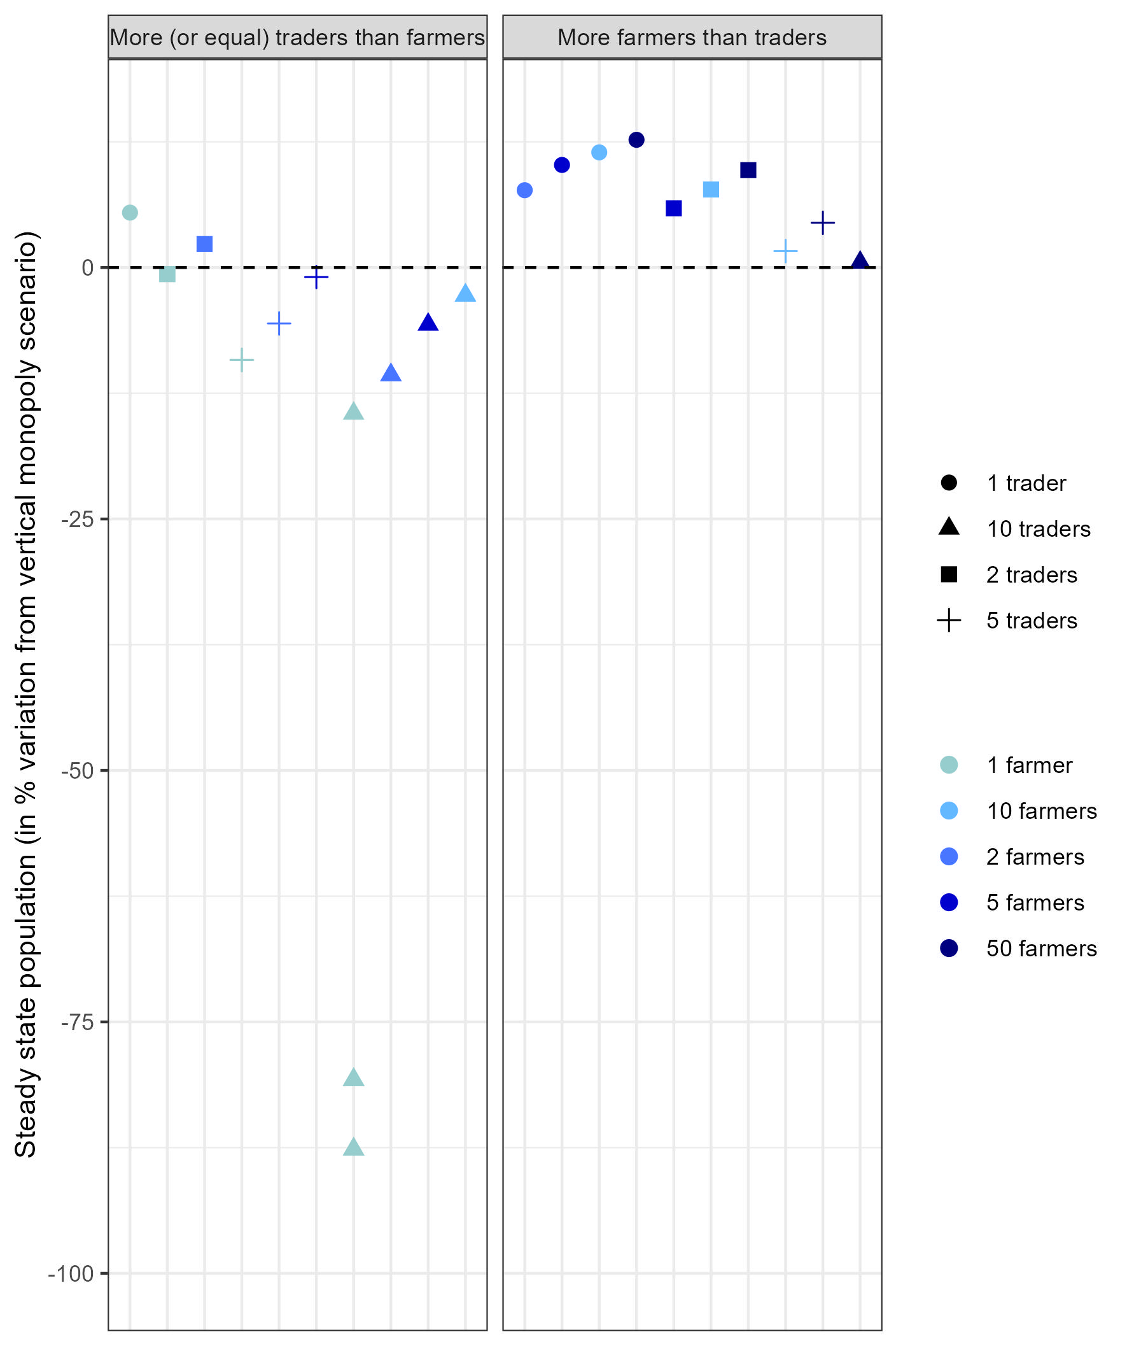
Oligopoly model : many farmers, many traders.
Assume M farmers and N traders, identical
Cournot: if there are more farmers than traders, conservation benefits
Intuition : increase in trader competition increase aggregate poaching
This needs to be counteracted by lots of farming operations
Bertrand equilibrium : invariant to the number of players, market share is just divided
Notes:
Limited number of farmers as there are set-up costs, which we have averaged in the unit production costs, but they exist.

Slide 74
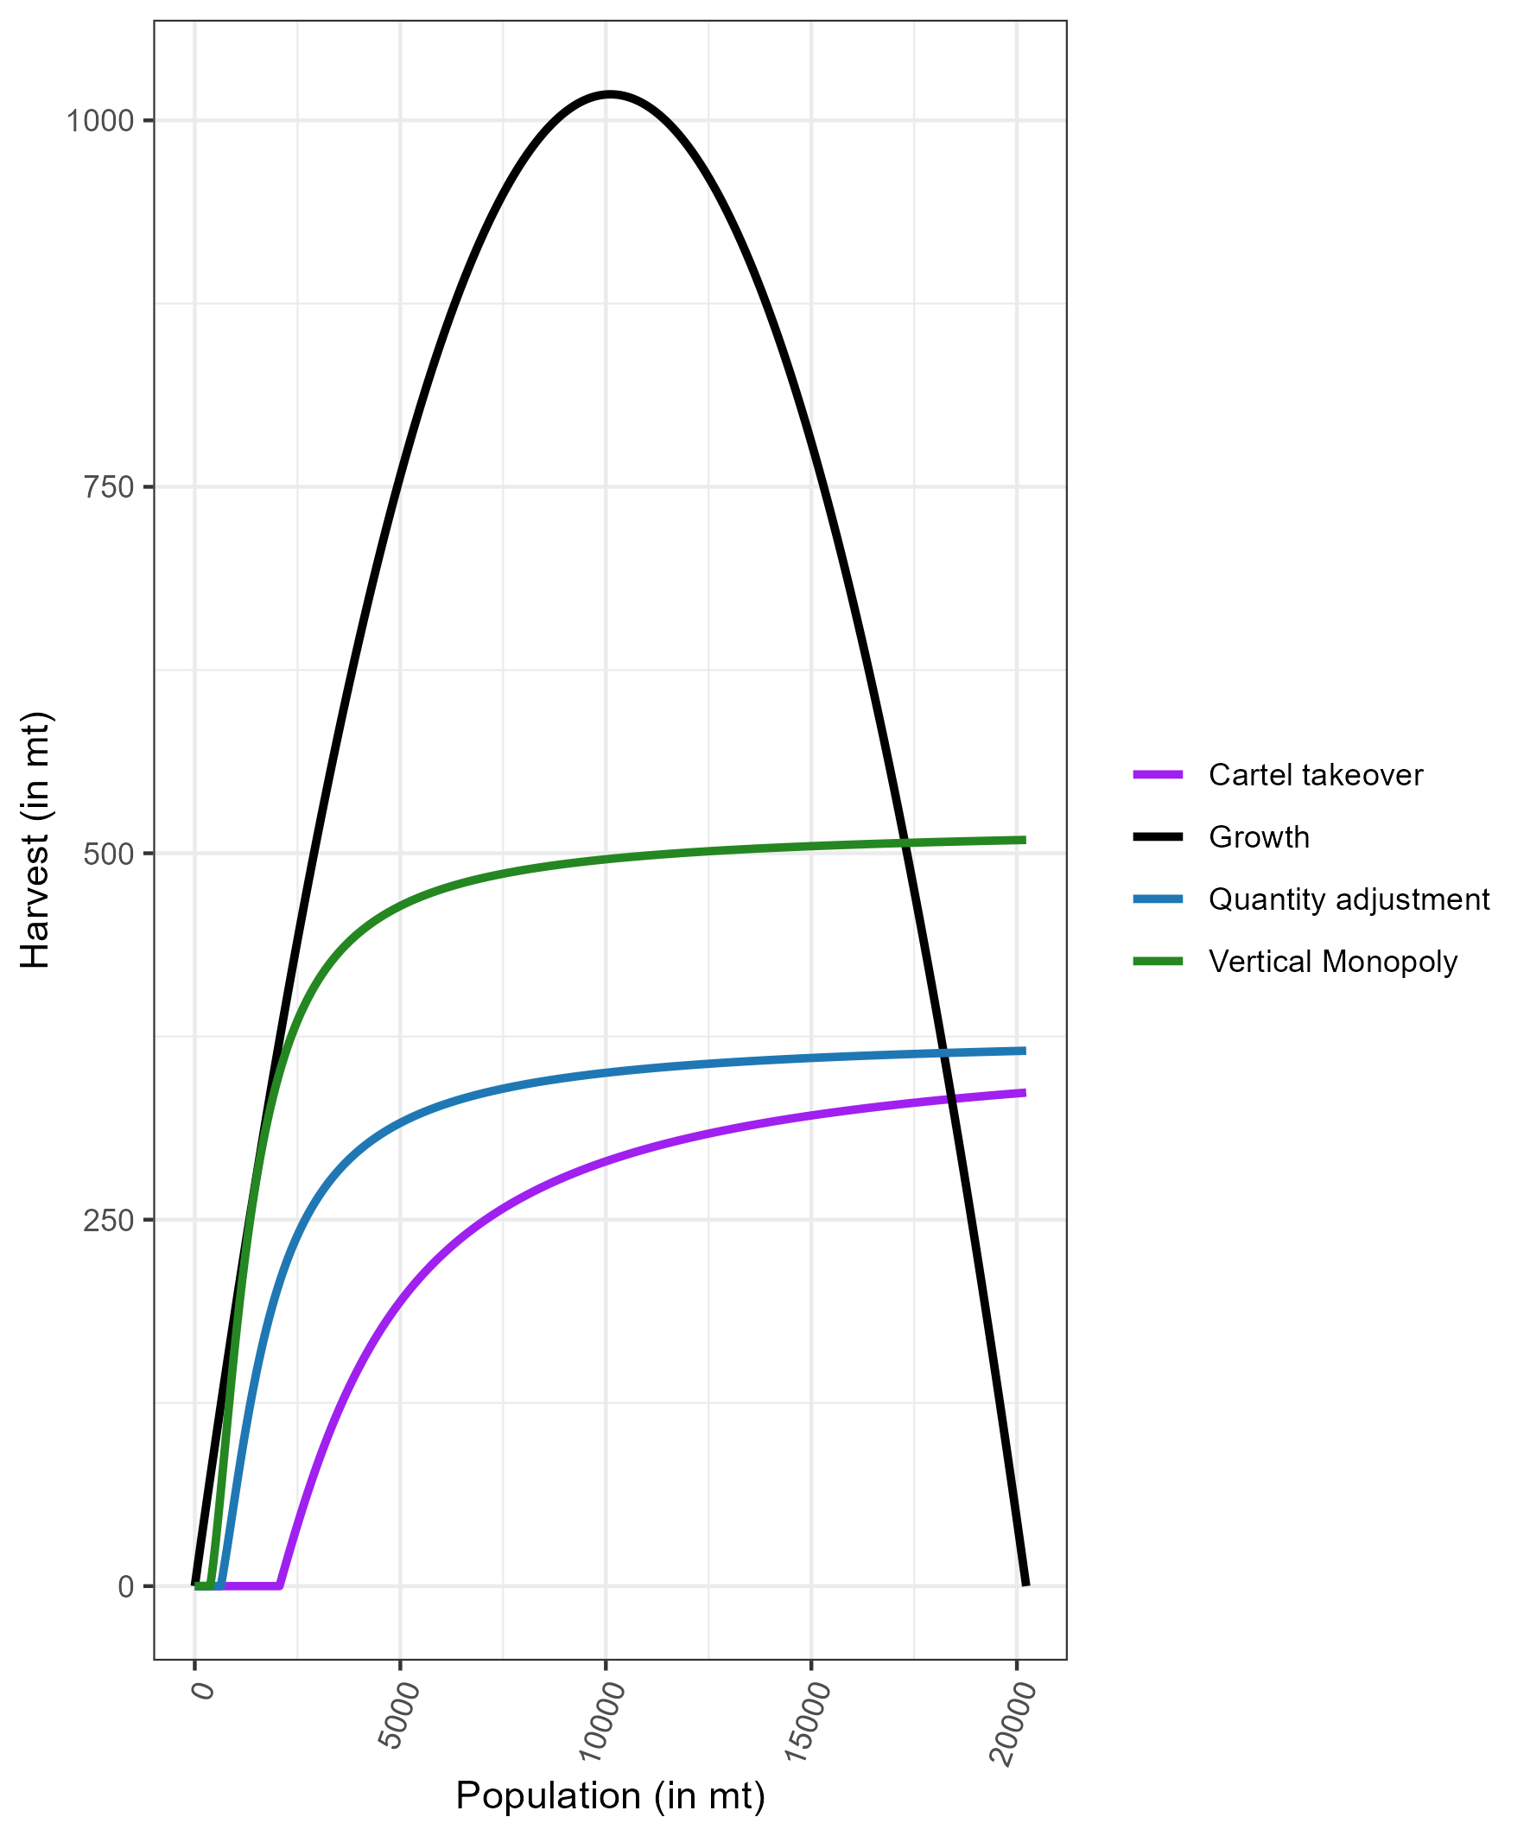
Cartel take-over
Collusion outcome
Monopoly with different production sites :
One with variable production cost, which increases as stock decreases
One with constant production cost
Use the variable production method until it is as costly as the constant production cost method
Results in even larger conservation benefits :
Restriction of quantities and relative cost effect
Notes:
Reportedly been the case of cartel takeover legal means of production, in the case of Shrimp in Sinaloa.
However, have not seen a conjunction of (i) monopoly, (ii) on an illegal market, (iii)

Slide 75
Calibration
Back to appendix list Back to chapter
Notes:
Toutes les nouvelles analyses de sensibilité du papier, et voir les chiffres sur les stated preferences, peut être les articles qu’on nous a envoyé au sujet des vietnamiens.

Slide 76
Biological data
Use reproductive data r from FishBaseR
Use stock assessment for carrying capacity K
Use Von Bertalanffy growth between captive and non captive fish to assess:
How long it takes to grow in the two environments
And how long does it take to grow to the average totoaba observed on the markets
Fishing cost
Reconstruct observed cost, including fuel, gear, gear replacement, bribes across seasons (low, middle, high)
Match with seasonal fishing effort to build seasonal (increasing) cost of effort
Find linear quadratic approximation that best matches the observed trend

Slide 77
Demand data
Use seizure data from 2013 to 2017 which map quantity, price and size of swim bladder Assume a single market
Use stock assessment for catch and biological production
Regress observed price on estimated catch
Farming costs
Set up costs and operational costs including : sphere, feed, labor, fuel, maintenance, cleaning, administrative from Earth Ocean Farms
10% annual interest rate to form a conservative estimate.
Notes:
)

Slide 78
Sensitivity analysis
Back to appendix list Back to chapter
Notes:
Toutes les nouvelles analyses de sensibilité du papier, et voir les chiffres sur les stated preferences, peut être les articles qu’on nous a envoyé au sujet des vietnamiens.

Slide 79
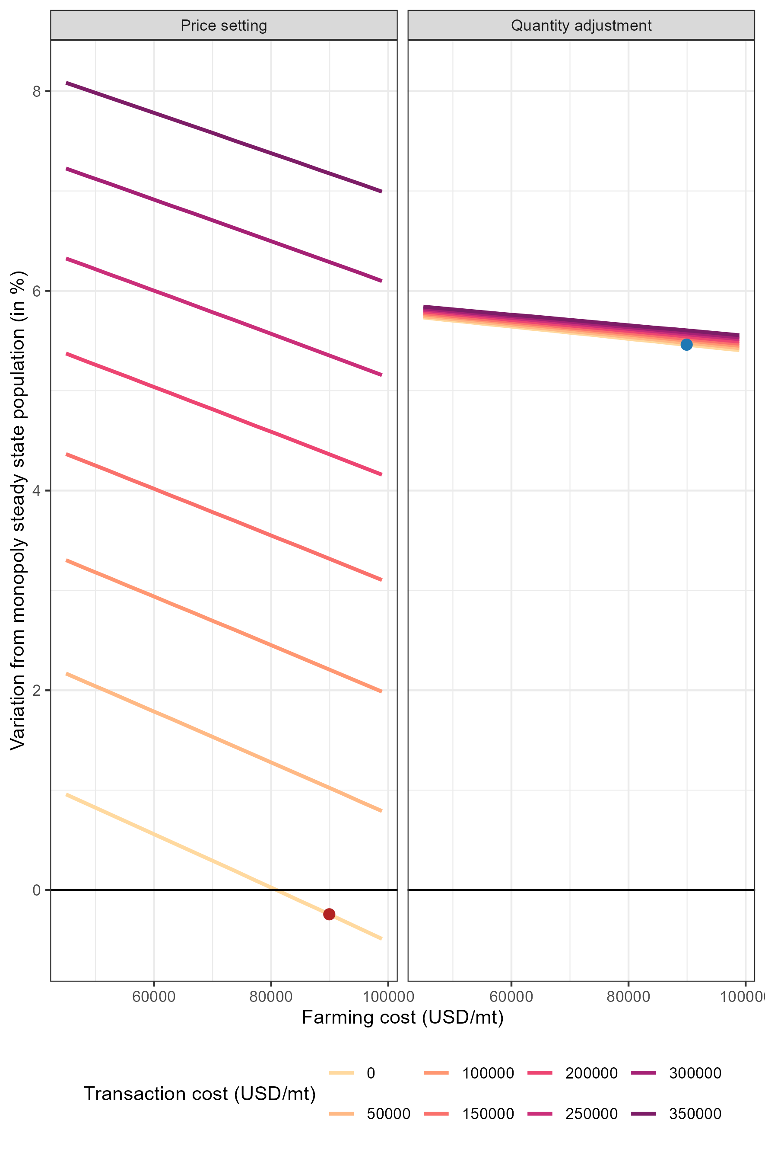
Departing from the conservative transaction cost estimate
With large transaction costs :
Better results in the case of Bertrand competition
Small results in the Cournot case
Increase in farming costs are an issue and cause decline in steady state population

Slide 80
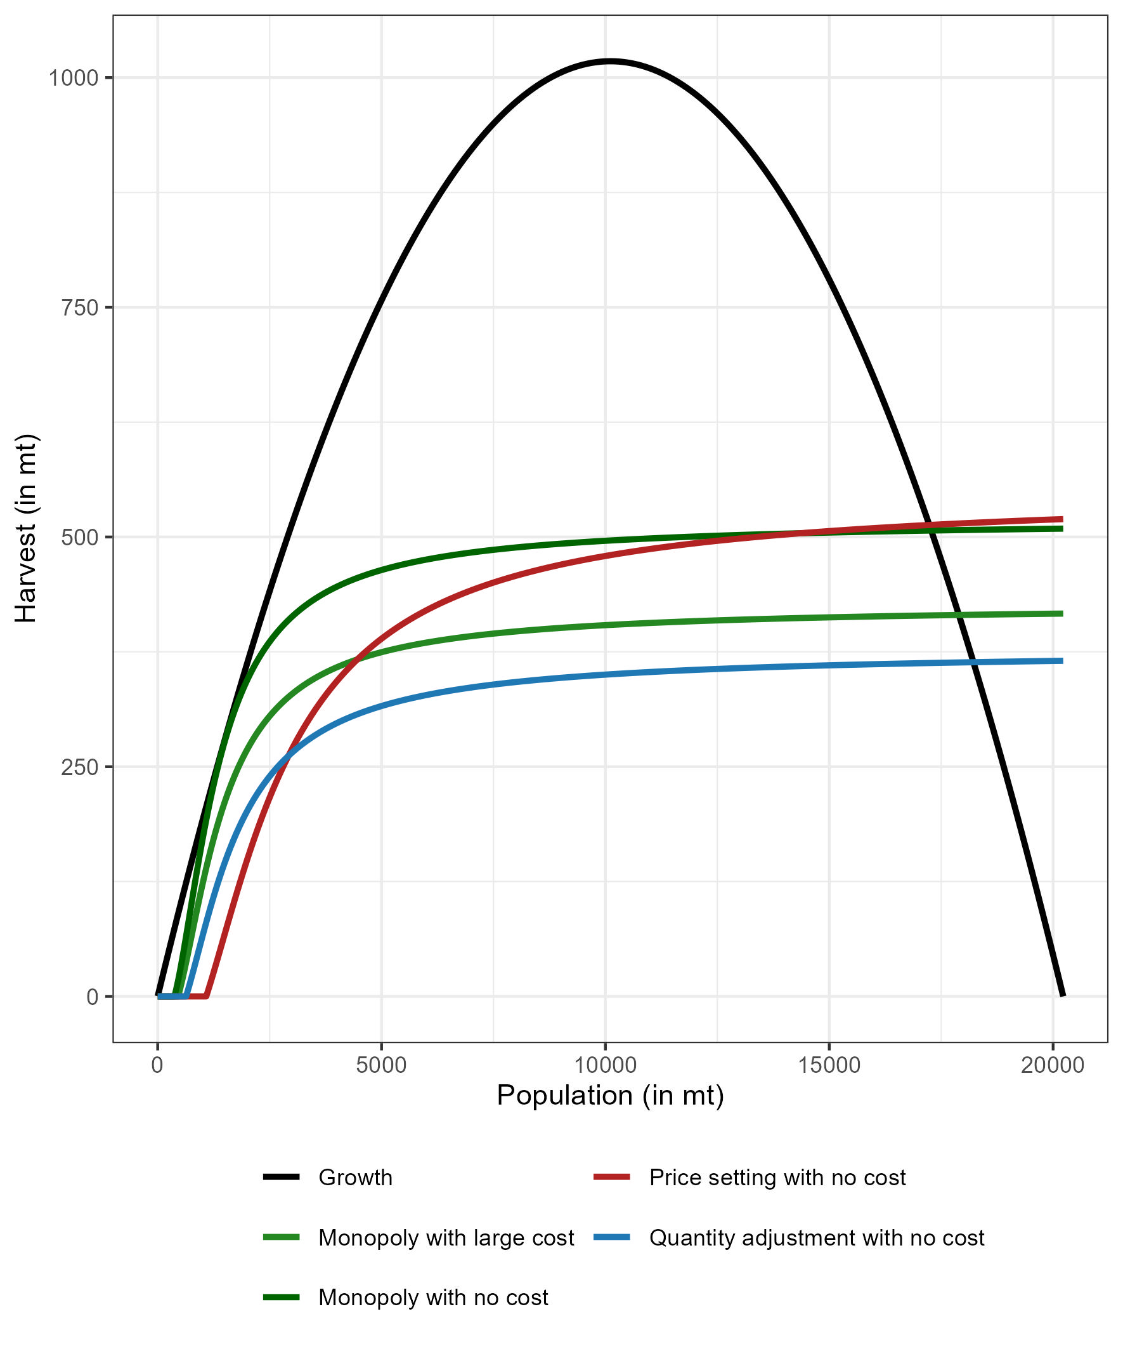
Departing from the conservative transaction cost estimate
Laundering effect : legalizing the trade of totoaba (with export permit) lowers the transaction costs

Slide 81
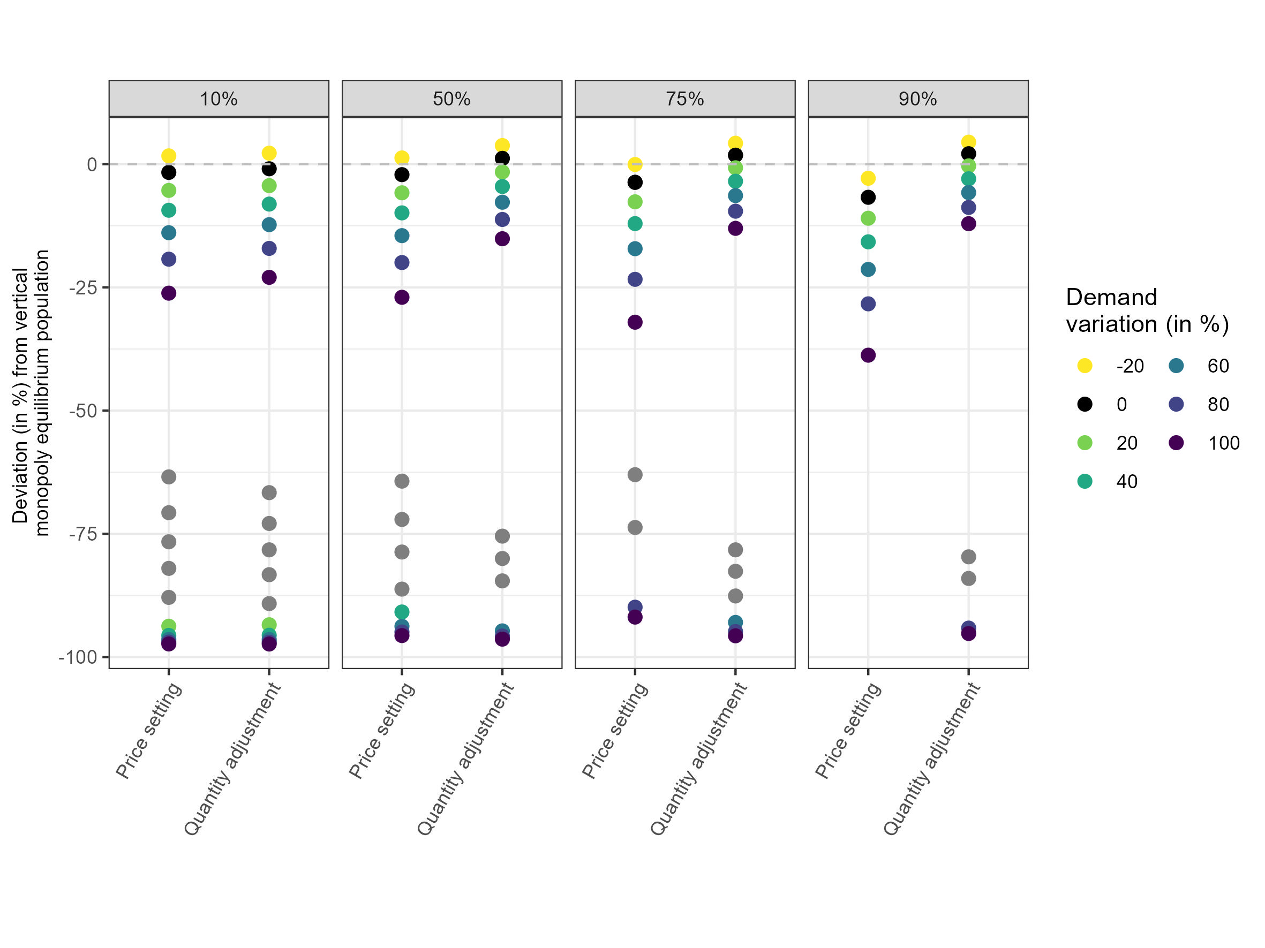
Joint effects of substitutability, demand increase and laundering
Notes:
In the case of increased demand, as well as a lowering in the price of wild totoaba, we see that
moderate increases in demand can be tolerated (below 20%) in the quantity scenario under high substitutability, a little more if substitutability is very large
If substitutability is very low, this risks a population collapse.
Renew the call for integrated approach.

Slide 82
Contributions and critiques
Back to appendix list Back to chapter
Notes:
Toutes les nouvelles analyses de sensibilité du papier, et voir les chiffres sur les stated preferences, peut être les articles qu’on nous a envoyé au sujet des vietnamiens.

Slide 83
Main differences and contributions compared with the original article
We use different counterfactual scenarios and find different theoretical conclusions:
They reach the conclusion that Bertrand competition always leads to drastic stock decline
This conclusion is reached on false premises as they do not consider the correct counterfactual
 | On a single product market | On a two products market
Firm behaving like a monopoly
Firm behaving like a Bertrand duopoly
Key element overlooked previously : increase in poaching is limited by technology and supply chain:
As stocks plumet, fishing costs increase Key assumption : constant CPUE and no hyperstability
Traders dépend on the poachers
Notes:
For the welfare analysis part in a partial equilibrium setting :
Need information on :
Demand : can be a rough evaluation, our data may be suited but unsure
Profit change : we do it

Slide 84
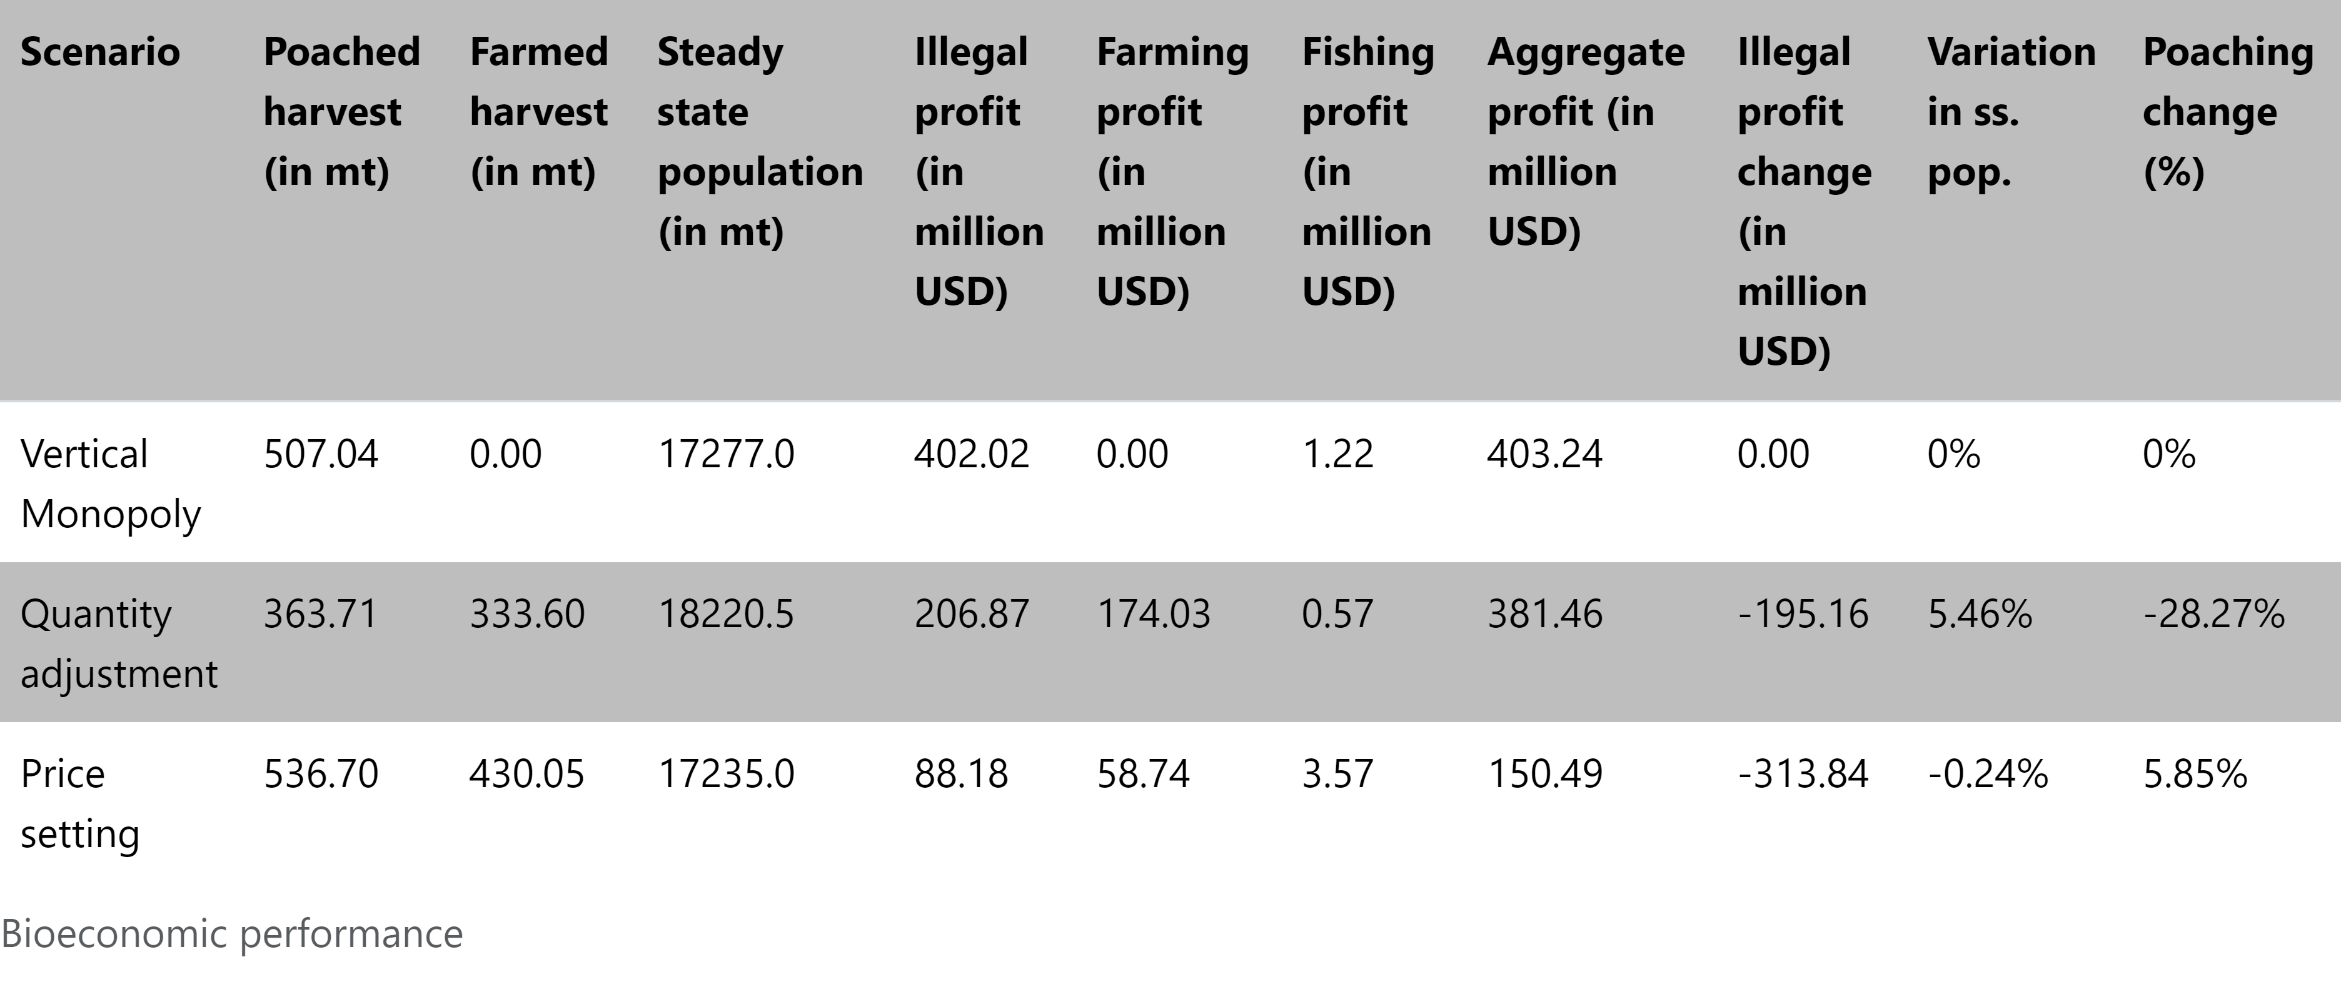
Policy effects on the supply chain
Notes:
We do not have overall a welfare analysis
However, we quantify the effects of policy measures at different levels of the supply chain
For a partial equilibrium analysis :
Need consumer side : we could estimate the loss in consumer surplus
Need non consumptive benefits : very difficult to integrate, as they are unknown, especially related to the vaquita
For a more general equilibrium approach, we lack too much data :
Reuse of the fleet on the fishery
Enforcement cost data
Ethically, not sure how a social planner would weigh the impact of decreased profit of the cartel, which could be good.

